Slide 1
AROUND THE WORLD IN 239 DAYS
Train the Trainer On Tour

Slide 2
Industry Workshop
NOC and Drilling Contractors
Ownership and Accountability

Slide 3
Field Visits
Unique Challenges / Learnings
Drops Committee Established

Slide 4
Sponsored DROPS TTT
Full Supply Chain Attendance
Limited Exposure to DROPS

Slide 5
Three Year Project
Comprehensive DROPS Scheme
Significant Resources

Slide 6
Greater Awareness
Exploiting Web Resource
Regional Authority Interfaces

Slide 7
Thirst for Knowledge
NOC Requirements
Certification and Competence

Slide 8
Operator Influence
Business Culture Challenges
Huge Demand for Training

Slide 9
COMMON FINDINGS
Consequences…
Limited Scope (still perceived as a Drilling, Lifting or Work at Height issue)
DROPS Member Communications
DROPS Calculator application
Definitions and Descriptions
Distorted Priorities

Slide 10
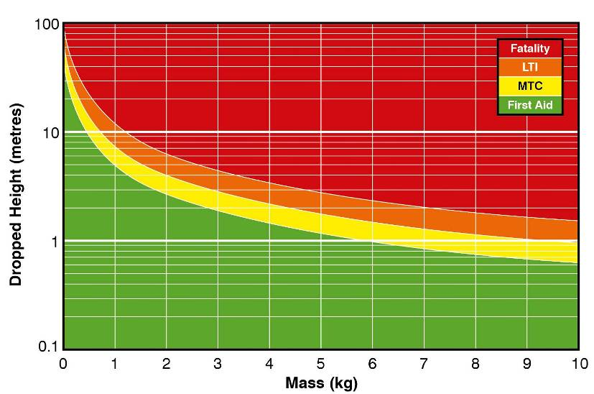
DROPS CALCULATOR
Notes:
There are a number of tools and techniques available for classifying the potential consequences from potential dropped objects. Many companies will use their own tool or technique and all the tools are for guidance only. There are simply too many influencing factors/variables for any tool to accurately predict the consequences of a potential dropped object. Some of these variables are difficult to quantify and build into a simple model, eg the shape of an object and its impact on the person, the operations and controls already in place. Hence the reason why this is a tool and guide to provide some starting point for investigation.
One such guidance tool, known as the DROPS Calculator, is offered by the DROPS Workgroup.
>>The legend may require some explanation,

Slide 11
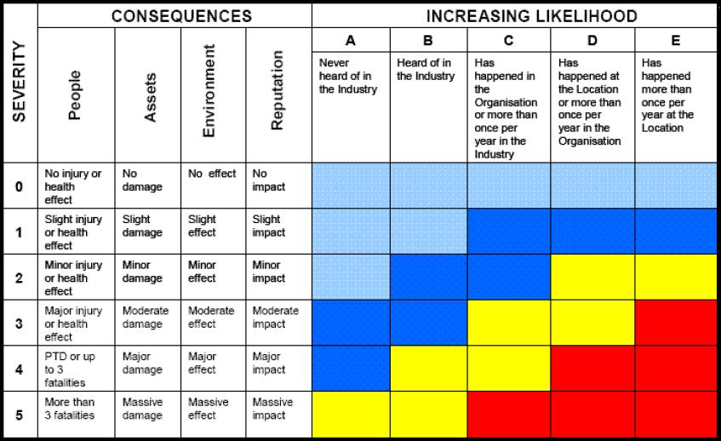
DROPS CALCULATOR
Notes:
Consider the RAM tool. This is the tool used by many organisations. We must use this tool to record ACTUAL Consequences and POTENTIAL Consequences.

Slide 12
UNDERSTANDING DROPS DEFINITIONS
Primary Fixing, Secondary Retention and Safety Securing
PRIMARY FIXINGS
Nuts, bolts, screws
Clamps, Pins, Hinges
Brackets, Turnbuckles
Welds
PREVENTIVE
SECONDARY RETENTION
Safety Pins
Lock Wire
Locking Nuts
Locking Washers
PREVENTIVE
SAFETY SECURING
Securing wire
Connectors
Nets and Baskets
Safety Chains
MITIGATING
Notes:
From earlier you’ll recall that a Primary securing device is the principal means of securing the item to a structure. Examples of primary security include Nuts, bolts, screws, Turnbuckles, Clamps, Brackets and Welding.
Secondary Retention is a device fitted to retain the item if the primary securing arrangement fails. Examples of secondary securing devices include Wire slings, Encasement, Lock Nuts, Split pins, roll pins, spring clips, Lock Washers, tab washers, Clamp and safety chains and Lock Wire.
With all these measures, it is important that the correct and best method of securement is used – there are anti-locking nuts/bolts and washers for instance or those that are pre-tensioned.
It is important also that if installing improved retention systems and the like that these are risk assessed as it may be by “fixing” one problem you import another.
Also consider Torque, and the need to retain torque in the bolt by means of the nut. Secondary retention is of course the locking washer. Be aware that in some instances, the split pin is being incorrectly identified as the secondary retention for the bolted connection.

Slide 13
DROPS INSPECTION
Static Drop Potential?
Dynamic Drop Potential?
Moving / Hinged Parts?
Snagging?
Vibration?
Corrosion?
Primary Securing?
Secondary Retention?
Safety Securing?
Shock Load?
Human Error?

Slide 15
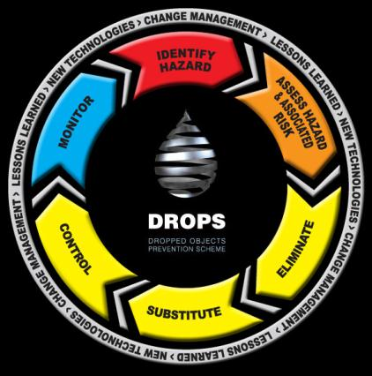
HOLISTIC APPROACH
Engineered Controls
Procedures
Training/ Awareness
Safety Signs and Signals
PPE
Preventive Controls may already exist! Any new Controls must be assessed and monitored.
(Management of Change)
Notes:
This is the DROPS process. It is very similar to our Hierarchy of Controls.
IDENTIFY HAZARD / ASSESS HAZARD: Using our observation techniques, Hazard Identification Tool and DROPS Calculator, we have quickly identified the hazard and assessed the risk.
ELIMINATE/ SUBSTITUTE/ CONTROL: Can we eliminate? If we cannot, can we substitute – maybe a different tool or a change in the way we approach the task. If not, then let’s put a control in place.
We have a wide selection to choose from, like an array of weapons in our armoury to help fight dropped objects.
Two key points to remember. Some of these controls are proactive or have already been designed in. Secondly, and perhaps more importantly, every control we do put in place may in turn create a new hazard.

Slide 16
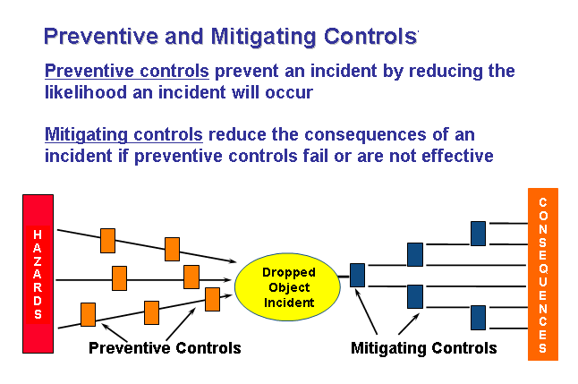
BOW TIE MODEL
Notes:
Consider the Bow Tie model where appropriate…discuss a scenario to ensure understanding.
The majority of secondary safety systems are indeed Mitigating controls, as are Barriers and Tannoy announcements.

Slide 18
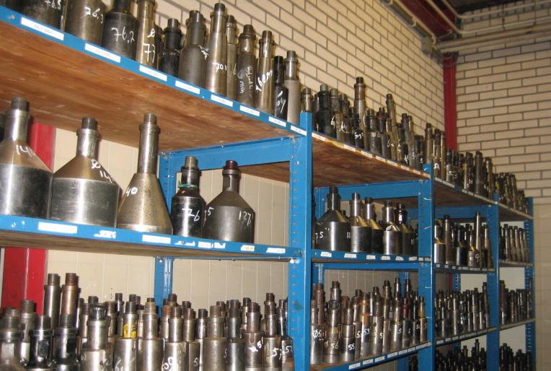
WHAT CAUSES DROPPED OBJECTS?
Planning and Operational Omissions and Miscalculations
Lack of planning, Lack of risk assessment, Errors in space / load planning
Notes:
Detail examples of Planning and Operational Omissions and Miscalculations. Invite delegates to consider other examples and show visual example. Items falling from shelving account for a great number of dropped object incidents in industry. Some have resulted in death.

Slide 19
ACTIVE AND ENGAGING LEADERSHIP
Continually raise awareness throughout Supply Chain (Forums, Reliable Securing booklet)
Apply DROPS Tools correctly to realise benefit (particularly Calculator)
Ensure all tasks follow the fundamentals of Task Risk Assessment (provide appropriate support)
Enforce basic safe working practices
Eliminate incidents caused by human factors
Keep DROPS at the forefront of the Business

Slide 22
Dropped Object Awareness and Prevention

