Slide 1
august 2024 DROPS Meeting
DROPS North America

Slide 2
Agenda
Introductions
  Jerry D. Eubank, PhD – Regional Chairperson
  Ross Jambon - Regional Secretary
Brief Anti-trust Guidelines
Safety Moment
Q4 Forum
  Time
  Location
  Meals
  Speakers / Presentations
Charter and By-Laws feedback / questions
Close

Slide 3
Anti-trust guidelines
No promotional remarks or discussion of purchase, sale, or pricing for goods and services.
No sharing or discussion of confidential or proprietary information.
No discussion of mergers, acquisitions, and divestment plans.
No sharing or discussion of compliance costs.
No discussion about how companies intend to respond to potential or actual government action.
No disparaging remarks.

Slide 4
Safety moment
A wireline crew was getting ready to remove a tool assembly from the well with wireline equipment already suspended overhead.
One of the crew’s operators asked a third party to operate the winch controls and lift the tool while he and the other wireline operator cleaned the assembly as it was removed from the well.
The third party operated the mast extension control lever instead of operating the winch line control lever in the hoist mode and the tool assembly lifted from the well. The wireline crew continued their task assuming that the winch was being operated correctly.
A secondary winch held the pack off and crossover sub near the top of the mast. As the mast telescoped, the ball on the winch line was pulled into the sheave. The secondary winch line parted and the suspended equipment fell.
The wireline crew heard the line part and tried to get clear of the falling equipment, but the wellhead impact guard prevented them from moving outside the strike zone.
A wireline operator’s forearm was struck by the falling pack off/sub-assembly. The result was a serious injury and hospitalization.

Slide 5
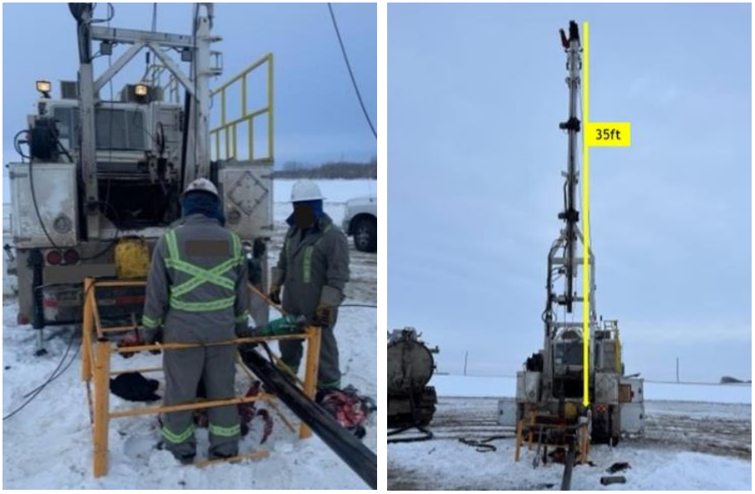
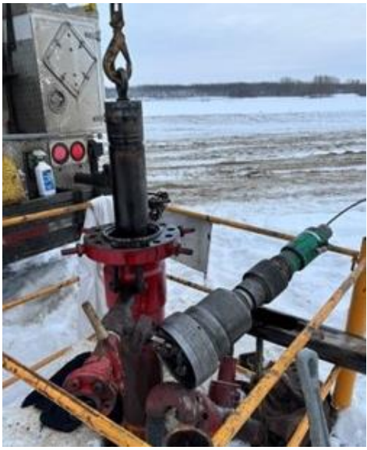
Safety moment

Slide 6
Q4 Forum
  Time
  Location
  Meals
  Speakers / Presentations
Notes:
November 6th from 08:00 to 15:00
Location: United Safety – Katy / 16430 Park Ten Place, Houston, TX
GRIPS – Marcelo to contact about
3M DBI SALA – Douglas Bay to contact
DROP Safe – Douglas Bay to contact
AXESS surveys – Marcelo to contact
NOV automation – Ellen
Open forum discussion

Slide 7
Charter and By-Laws feedback / questions
Develop positions?
Establish term limits?
Operator sponsorship?
Attendance requirements?
Notes:
Detailed discussion to be held at next meeting. Please prepare ahead of time.

Slide 8
Closing comment/notes

