Slide 1
Centrica – Wells DROPS Initiative
DROPS Forum – Feb 2016

Slide 2
Centrica – Wells DROPS Initiative
Why the need for a DROPS Initiative?
Our overall safety performance had deteriorated – incidents were on the up;
Well Operations had seen an increase in the number of Dropped Object Events & HSE Events;
Dropped Objects Events where on up within the wider organisation (over 240 Dropped object events since 2009);
50 of those had been classed as HiPo Dropped Object events.
Notes:
In 2014 alone we had 41 safety events in wells, 11 of which injured people, 9 events involved dropped objects 4 of which were classed as HiPo’s
Wider Centrica, we had 75 injurious events & 22 HiPo’s

Slide 3

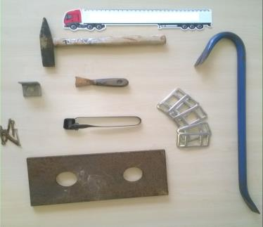
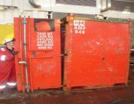
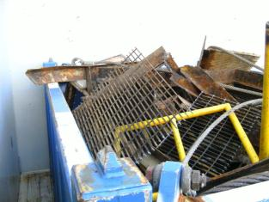
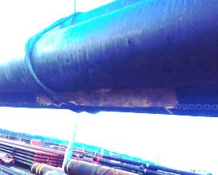
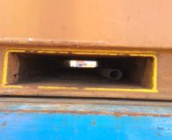
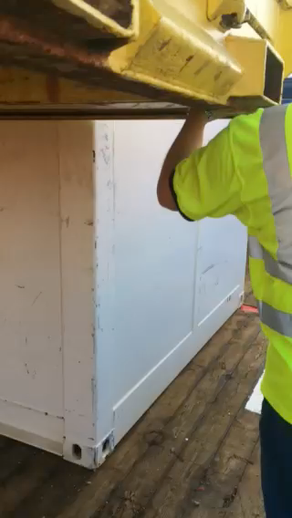
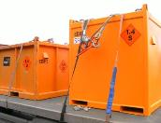
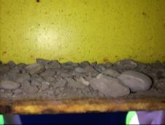
Centrica – Wells DROPS Initiative
Dropped Objects at Centrica
Notes:
The load goes on an average 1200mile road trip, through towns & villages, past schools, along motorways, maybe past you house or kids school or even in front of your car.
Items caught in sling / underside of load.
Cargo netting not used.
Items protruding over edges.
Debris from storage yard caught underneath unit
Angle bracket & split pins
Scraper, Webbing strap clips, Sparker
Chipping Hammer
6ft Scaffold pole inside FLT pocket
Container doors falling off

Slide 4
Centrica – Wells DROPS Initiative
What we did
TOFS held at offshore sites to seek feedback on our events in order to understand what was going on;
Developed a TOFS & DROPS pack to share and seek events as well as raise awareness in Dropped objects through the supply chain;
Visited 30 companies & spoke to over 2000 people both on offshore from Senior Management level downwards;
Raised awareness internally and externally on DROPS through varying means e.g. HSE Forum, Hazard hunts, Audits & Inspections, Inductions, DROPS Backloading Books etc..
Notes:
TOFS held offshore to seek feedback on our events,
Offshore crew asked what we where doing to raise awareness onshore
TOFS and DROP pack created
Initiatives:
Hazard hunts
Drops committee offshore
Audits
Backloading tags
Tagging out bound goods

Slide 5
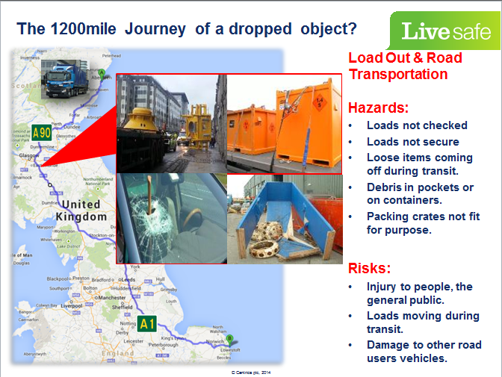

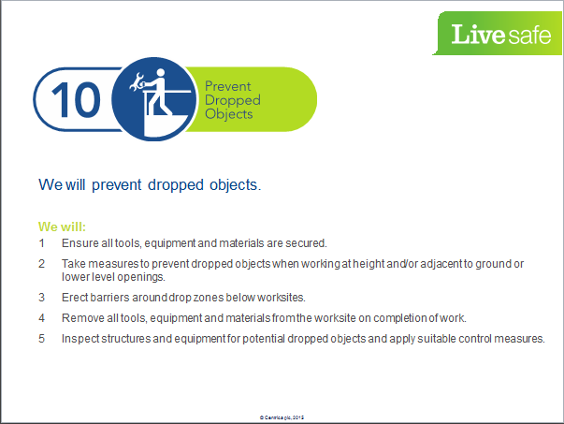
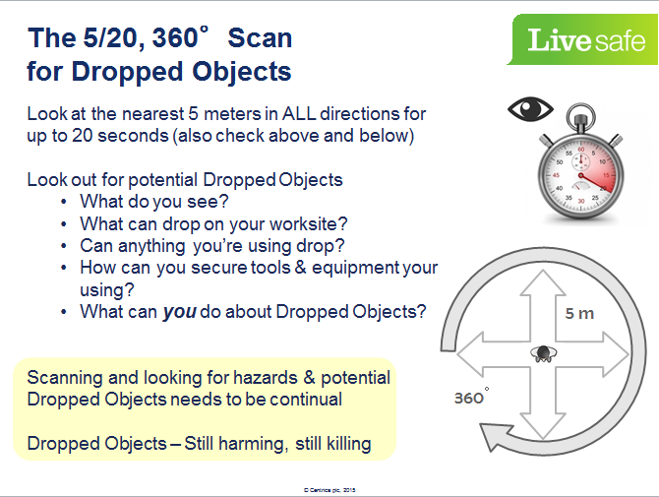
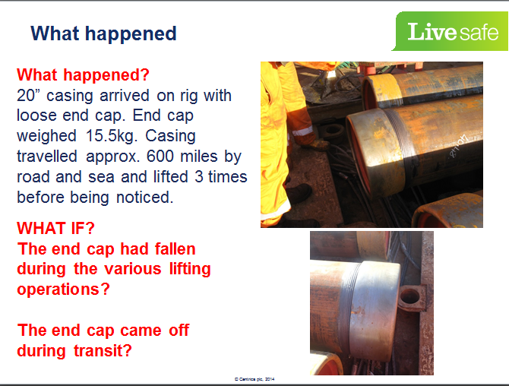
Centrica – Wells DROPS Initiative
TOFS & DROPS
Notes:
Livesafe rule
Shared our events not just dropped objects
5/20, 360 deg scan
Journey of a dropped object

Slide 6
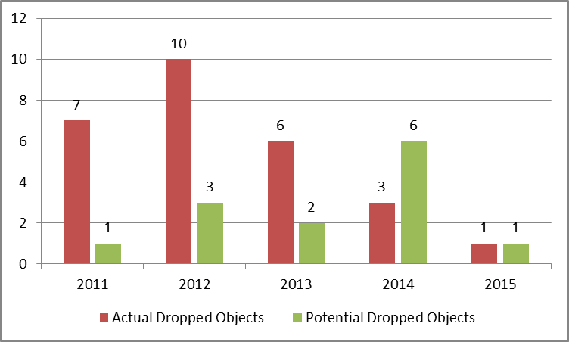
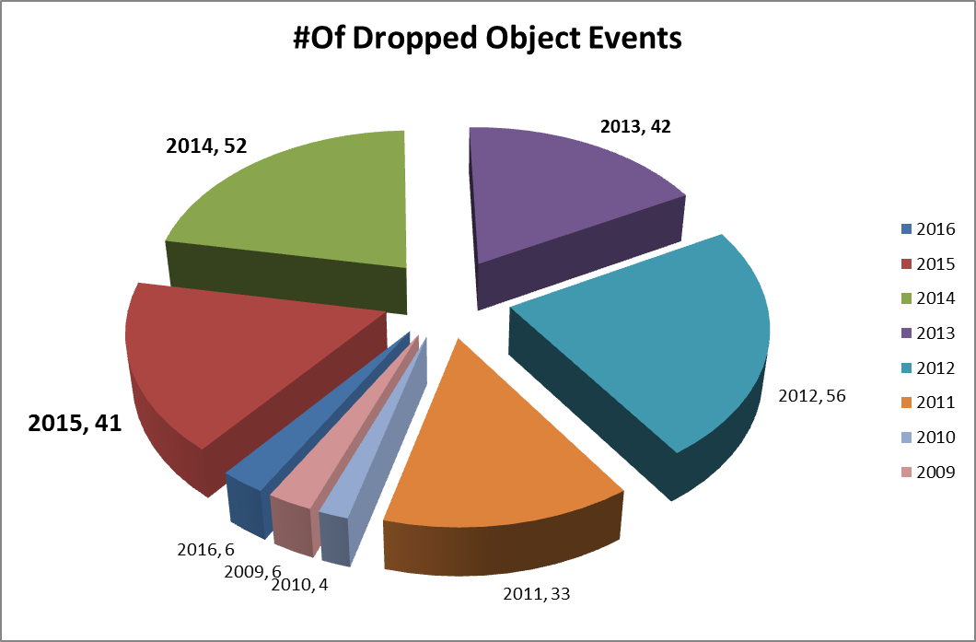
Centrica – Wells DROPS Initiative
Improvement Success
We have quite literally Dropped the number of Actual & Potential Dropped objects incidents.
Significant reduction in actual and potential Dropped Objects.
Increased awareness both on & offshore
Well Operations
Centrica UKNL
Notes:
Increase in # of STOP / Livesafe cards relating to potential dropped objects.
Vendor feedback at varying meetings
2013 – 42
2014 – 52
2015 – 41

Slide 7
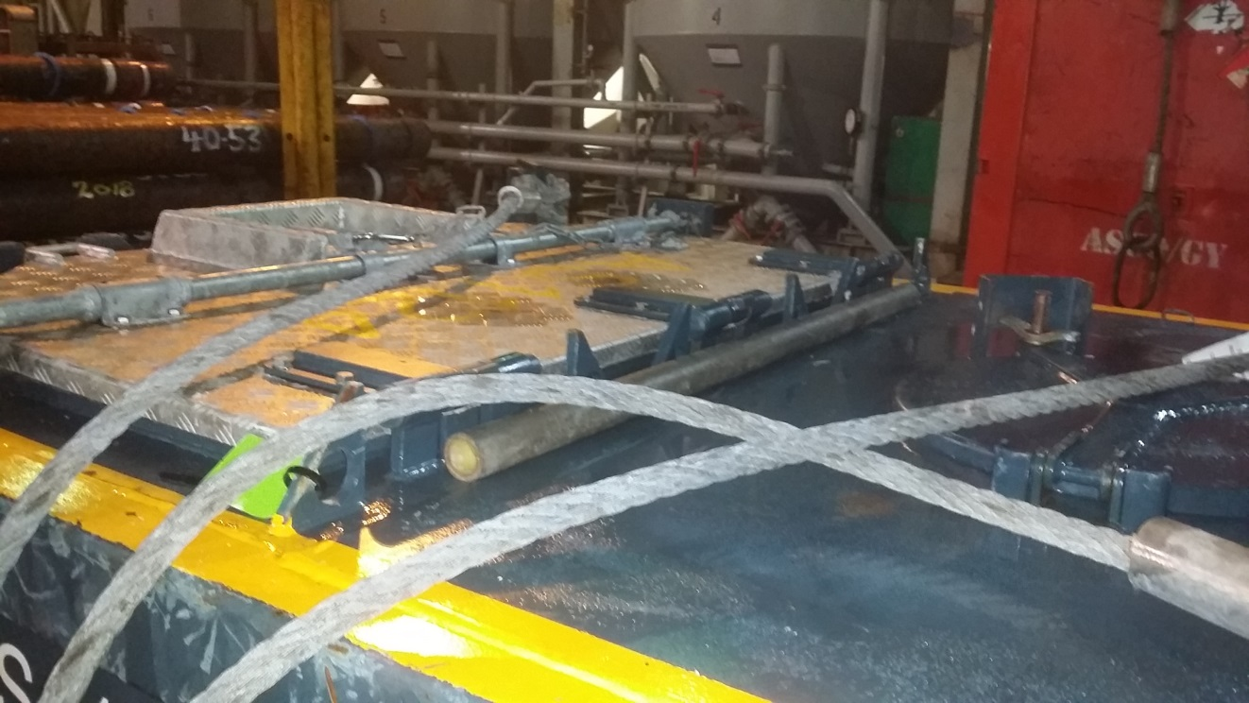
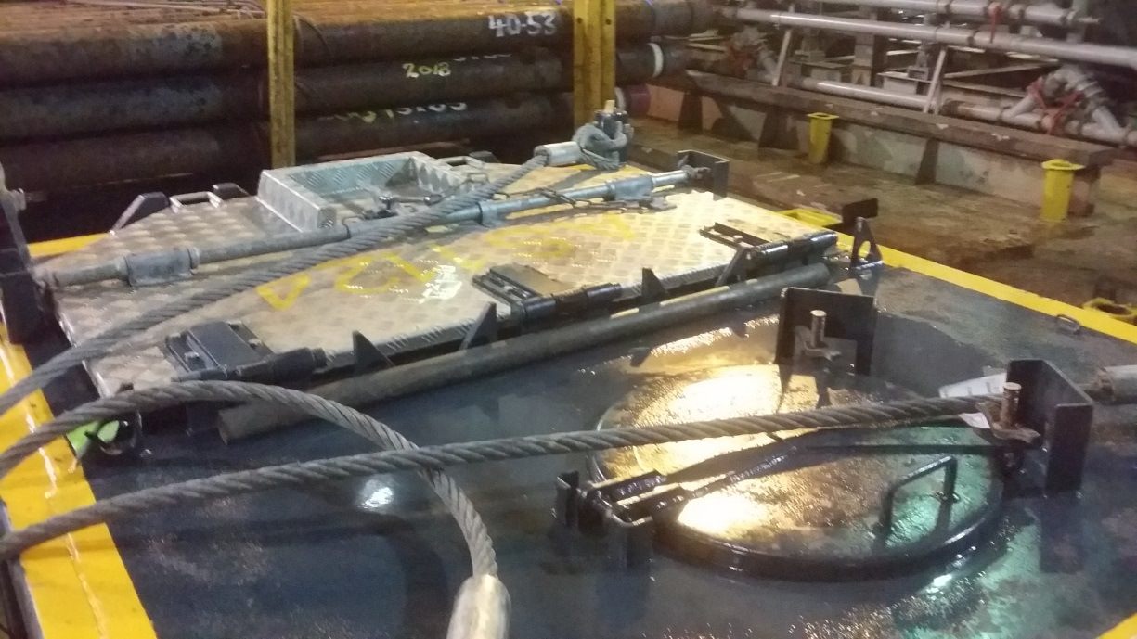
Observation test
Scaffold Bar
Can YOU Spot the hazard?
Notes:
Can you spot the HAZARD, ask the room to see if they can spot that hazard

Slide 8



If in doubt…
No matter what role you have, please consider Dropped Objects, because removing or preventing Dropped Objects saves lives.
Notes:
BRIEFING NOTES:
If in doubt, STOP, THINK, ACT

