Slide 1


Slide 2

DROPS Focus Groups
DROPS Focus Groups
Human Factors
Maintenance & Inspection of Secondary
Retention and Secondary Securing
Communicating DROPS Best Practice through Supply Chain (to Manufacturers)

Slide 3
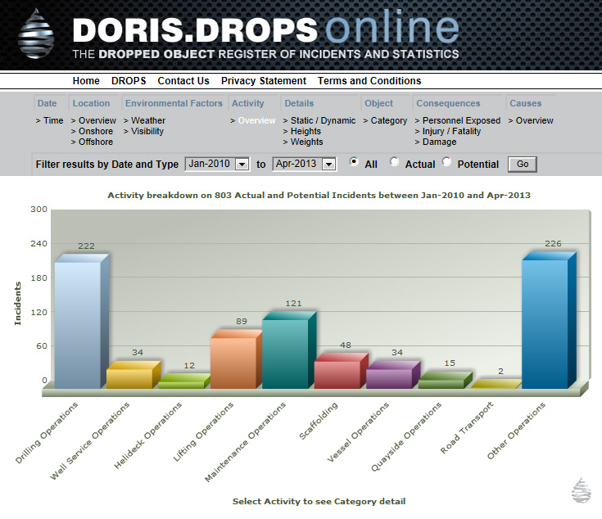
DROPS Focus Groups
DORIS Focus Group 2016
Database stabilised and being used
Discussions held with Key Users
Build not fit for Future purpose
New build discussed with specialists
Establish Focus Group to address:
  Broader engagement and support
  Scope, Functionality and Maintenance
  Finance

Slide 4

DROPS Focus Groups
Reliable Securing Focus Group
    First Focus Group Meeting held this week
    Discussed comments gathered from last Forum and major comments on file
    Established “owners” for review of individual sections
    Section Owners to review comments, seek further input and specialist consultation
    Section Owners to present update recommendations at next Focus Group meeting on April 28th
    Goal to complete update December 2016 and publish new booklets January 2017

Slide 5
DROPS Focus Groups
Reliable Securing Focus Group
High level guidance document, best practice as agreed by DROPS members. (No standard or formal requirement, just recommendations)
Avoid product names in favour of function or method descriptions
10% additional content - new equipment types
Retain pocket-book format with members receiving high resolution electronic versions
Explore print and production cost models, including sponsorship opportunities

Slide 6
DROPS Focus Groups
Reliable Securing Focus Group
Still opportunity for members to suggest input
or changes (to admin@dropsonline.org)
Please support calls to broader membership for input from the review team
Review “gateways” with Focus Group and Steering Committee
Draft challenge and comment opportunities for all members including Regional Chapters through DROPS Focal Points
All decision making and approvals by majority consensus

Slide 7
DROPS Focus Groups
Best Practice Updates 2016
As a follow-on from update of Reliable Securing, we will update all DROPS Best Practices:
    - Tools at Height
    - Red Zones
    - Dropped Object Surveys
    - Pre-task Checks
Potential new Best Practices or Guidance Documents may also emerge from review, eg:
    - Man-riding
    - Rigging Equipment (hooks, devices, slings etc)
Opportunity for all to submit any comment or input on above (admin@dropsonline.org)

Slide 8
DROPS Focus Groups
DROPS Focus Groups 2016
Already a full and challenging
schedule for 2016
Possible new Focus Group (by delegate consensus) at September Forum
At any time, members can suggest “quick hit” improvements, communications or products (to admin@dropsonline.org)

Slide 9



www.dropsonline.org

