Slide 1
IOGP Data
Safety Data Sub-Committee
Kirsty Walker, Schlumberger
Chair IOGP Safety Data Sub-Committee
DROPS Forum Meeting, 28 April 2016

Slide 2
Overview
  International Association of Oil and Gas Producers
  Data capture process
  Types of data reviewed
  Data privacy considerations
  Data review and reporting process
  Reports and insights

Slide 3
Who are IOGP?
IOGP encompasses the majority of the world's leading publicly-traded, private and state-owned oil and gas companies, industry associations and major upstream service companies
IOGP Members produce more than half of the world’s oil and over a third of its gas. They operate in all producing regions: the Americas, Africa, Europe, the Middle East, the Caspian, the Arctic, Asia and Australia.

Slide 4

IOGP - Global Membership
North America
Europe
Afren
Anadarko
API
Baker Hughes
CAPP
Chevron
CNR International
ConocoPhillips
Devon Energy
ExxonMobil
Hess Corporation
Husky Energy
IADC
IAGC
Kosmos Energy
Marathon Oil
Noble Energy
Pemex
Schlumberger
Suncor
Talisman Energy
ASSOMMINERARIA
BG Group
BP
Cairn Energy
DEA Deutsche
Erdoel AG
DONG Energy
E.ON Ruhrgas AS
Energy Institute
ENGIE
Eni
GALP Energia
IECO
IOOA
IPIECA
Maersk Oil
MOL plc
NOGEPA
Norwegian Oil & Gas
Oil Gas Denmark
Oil & Gas UK
OMV
Perenco Holdings
Premier Oil
Repsol
Shell
Statoil
Total
Tullow Oil
WEG
Wintershall
Russia & Caspian region
JSOC Bashneft
NCOC
Africa
South America
Sasol
Sonangol
ARPEL
IBP
Pan American
Petrobras
PLUSPETROL
Middle East
ADNOC
CC Energy Development
Dolphin Energy
Dragon Oil
Kuwait Oil
Qatar Petroleum
RasGas
Yemen LNG
ZADCO
Asia & Australia
APPEA
BHP Billiton
Cairn India
CNOOC
INPEX
Origin Energy
Papuan Oil Search
Petronas
PTTEP
Woodside

Slide 5
IOGP Data capture process
Voluntary program
IOGP member companies (including
contractor data)
Annual process
  Occupational safety
  Environment
  Motor vehicle crash
  Health
  Process safety
  Aviation
Continuous process
  Well control incidents
Data sets are owned by an IOGP Standing Committee and managed by a a Data Sub-committee or a Work Group
The groups conduct the required validation and analysis in co-operation with the IOGP Data Specialist
Reporting user guides are updated annually

Slide 6
Data collections
1985 – Occupational Safety
1999 – Environment
2008 – Motor Vehicle Crash
2010 – Health Leading Indicators
2011 – Process
Safety Events
2013 – Aviation
52 Companies
111 Countries
4.4 Billion work hours
Between 1985-2014:
Total 2,727 fatalities
Total 77,205 LWDC
Between 1991-2014:
1,911 fatal incidents
1,765 high potential events
43 Companies
86 Countries
2.1 Billion tonnes
HC production
35 Companies
73 Countries
1.8 Billion work hours
2.5 Billion km driven
304 Crashes
26 Companies
Worldwide data
44 Companies
107 Countries
487 Million work hours
892 Tier 1 PSE
276 Tier 2 PSE
25 Companies
64 Countries
Legend
Year data collection started.
Number companies participating in 2014
6

Slide 7

Data privacy
All databases are protected with very limited access rights
Each company provides a nominee for data sets
Communications via IOGP Secretariat Data Specialist
Raw data are not made available to the Data Work Groups
Results may be published on a by-company basis for benchmarking or validation purposes
Company codes are kept strictly confidential

Slide 8
Safety Data – Annual Process
Early April
SDSC* meets to review and validate draft report
Mid April
Safety Committee, SDSC* and contributors review draft
Early May
Management Committee approves draft
June
Final report published electronically
Early March
Submitted data checked and validated by Data Specialist
1 March
Deadline for submission of data
Early March
Fatal incident and high potential event reports validated by SDSC* Chair
Mid March
Companies check their normalised results

Slide 9

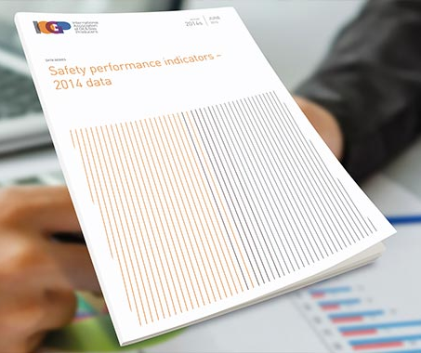
Report Structure and Content
Introduction giving background to the data and the purpose of reporting
List of participating companies
Executive Summary
Data analysis sections
Data tables in appendices
Glossary of terms

Slide 10
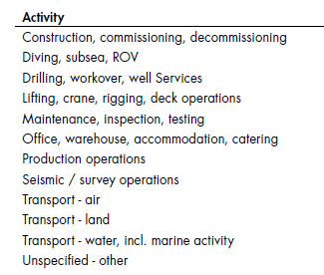
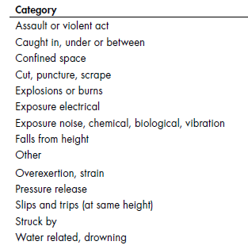
Data Analysis – Safety Performance Indicators
Overall results for participating member companies
By Region and country
By work function:
  Drilling
  Production
  Exploration
  Construction
  Unspecified
By incident category and activity
By Company (anonymous) then by function

Slide 11
Reports and insights - Safety Performance Indicators
Fatalities
Fatal accident rate (FAR)
Fatalities by incident category and activity
Number of fatal incidents per 100 million work hours (FIR)
Total recordable injury rate (TRIR)
Lost time injury frequency (LTIF)
Lost work day case categories and activities
Severity of lost work day cases
Severity of restricted work day cases
Incident triangles (Ratio of lost time injuries to fatalities and ratio of recordable injuries to fatalities)
Causal factors
Life-Saving Rules

Slide 12
Reports and insights - Safety Performance Indicators - 2015
3,719 million work hours
49 of 57 IOGP member companies reported
All member companies reported contractor data
76% contractor and 24% company work hours
Operations in 108 countries

Slide 13
Fatalities by Activity and Category
Work Related fatalities by category 2005 to 2015 inclusive
Work Related fatalities by activity 2005 to 2015 inclusive

Slide 14
Identification and Analysis of Causal Factors
The following 5 causal factors appear consistently in the top ten for both fatal incidents and high potential events for each year 2010 to 2015:
    Inadequate training/competence
    Improper decision making or lack of judgment
    Inadequate work standards/procedures
    Inadequate supervision
    Inadequate hazard identification or risk assessment
The most common causal factor for fatal incidents, which does not show in the top 10 for High Potential Events:
    Improper position (line of fire)

Slide 15
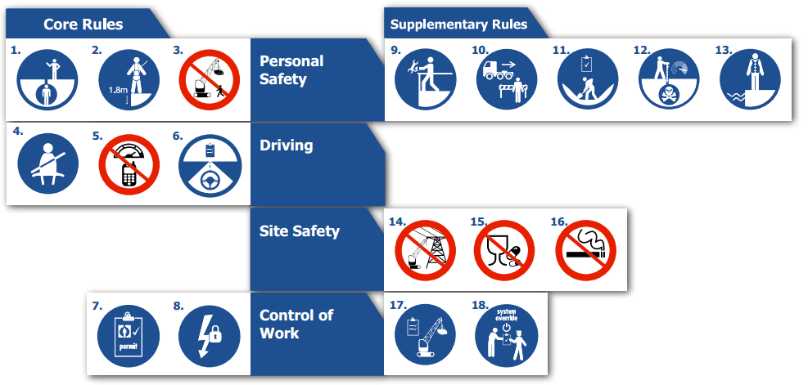
IOGP Life Saving Rules
Life-Saving Rules applicable to 2015 fatal incidents

Slide 16
Fatalities by Activity and Category
Work Related fatalities by Life Saving Rule 2005 to 2015 inclusive

Slide 17
Notes:
1 lifting
3 drilling
1 office

Slide 18
Notes:
1 lifting
1 seismic

Slide 19
Notes:
1 struck by
1 dropped object
3 caught between
1 fall from height

Slide 20
Typical Fatal Incident Report
Date: Jun 25 2015
UAE, Drilling
Number of deaths: 1
Category: Struck by, Activity: Drilling, workover, well services
Rule: Dropped objects
Employer: Contractor Occupation: Drilling/Well Servicing Operator
NARRATIVE:
A floor man was struck by a winch line that was under tension and got suddenly released when a lead sheave failed. The crew was in the process of laying down a joint of 5-7/8” HWDP (heavy weight drill pipe) with the use of rig floor tuggers. One tugger suspended the joint, while the second tugger was secured to the Samson post on one side of the V-door and led through a lead sheave, which was fixed to the Samson post, on the other side of the V-door. The tugger wire was being used to pull the joint of the HWDP to the V-door when the lead sheave failed under load.
WHAT WENT WRONG:
The Lead Sheave failed releasing the wire rope. The deceased was standing on line of fire. The rig drew continued laying down HWDP instead of waiting for the crane. Task difficulty. No specific operating procedure available for task of laying down the
HWDP.
CORRECTIVE ACTIONS AND RECOMMENDATIONS:
1. Develop rig-specific procedure for Lay-Down of Heavy Weight Drill Pipes and ensure competency of rig crew.
2.Examine availability of specific procedures for all rig operations, address the gaps and develop as necessary the relevant procedures.
3. Revise Job Safety Analysis and Risk Assessment Templates to include “line of fire” and “stored energy” factors
4. Provide awareness level (in-house) training on Hazard Identifications (Ex: Line of Fire, Stored Energy, STOP Card Policy etc.)
5. Any critical path primary or secondary tool has to undergo full evaluation from initial design to operation phase to ensure it meets proven standard design (in this case catwalk). Alternative solutions shall be thoroughly risk assessed for its suitability using design verification procedure.
CAUSAL FACTORS:
PEOPLE (ACTS): Following Procedures: Improper position (in the line of fire)
PEOPLE (ACTS): Use of Tools, Equipment, Materials and Products: Servicing of energized equipment/inadequate energy isolation
PEOPLE (ACTS): Use of Protective Methods: Inadequate use of safety systems
PEOPLE (ACTS): Inattention/Lack of Awareness: Lack of attention/distracted by other concerns/stress
PROCESS (CONDITIONS): Protective Systems: Inadequate/defective guards or protective barriers
PROCESS (CONDITIONS): Protective Systems: Inadequate/defective warning systems/safety devices
PROCESS (CONDITIONS): Tools, Equipment, Materials & Products: Inadequate/defective tools/equipment/materials/products
PROCESS (CONDITIONS): Organisational: Inadequate work standards/procedures
PROCESS (CONDITIONS): Organisational: Inadequate communication
PROCESS (CONDITIONS): Organisational: Inadequate supervision

Slide 21
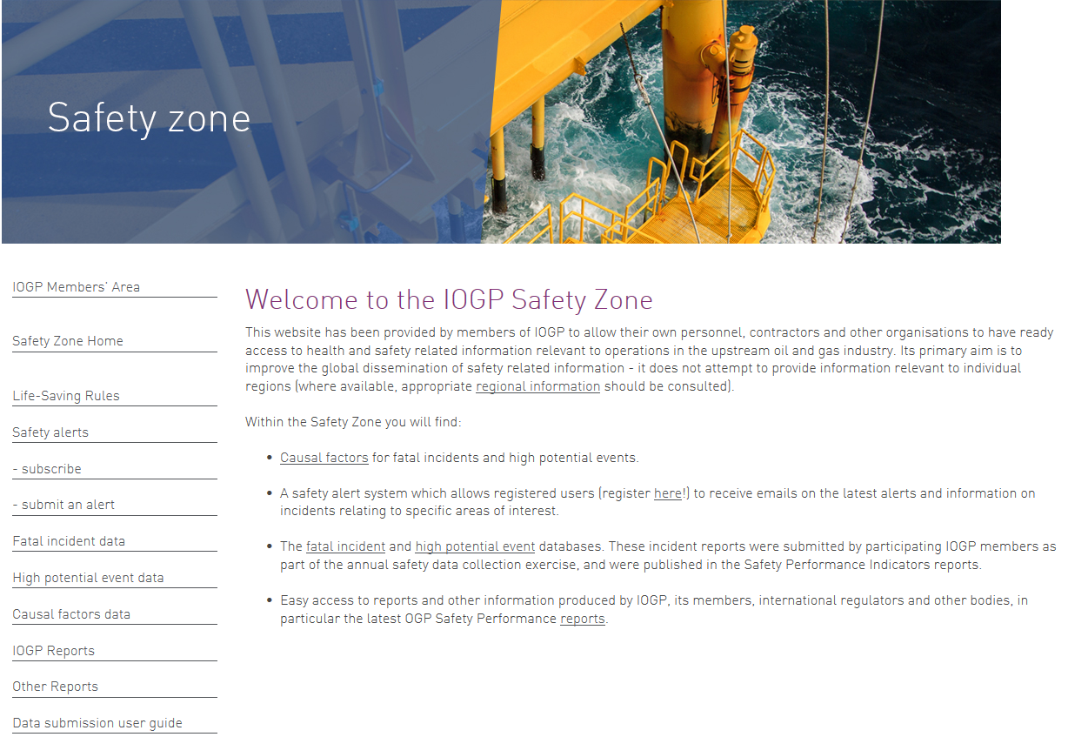
IOGP Safety Zone

Slide 22
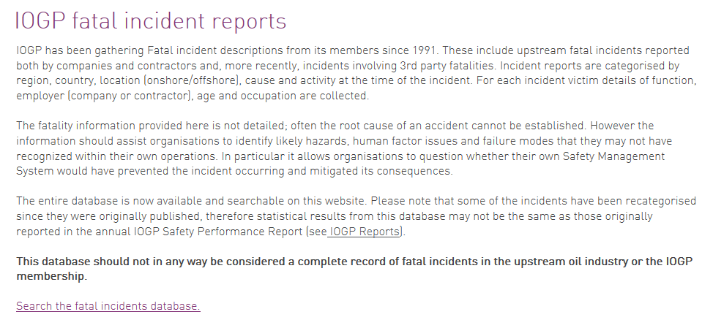
IOGP Safety Zone

Slide 23
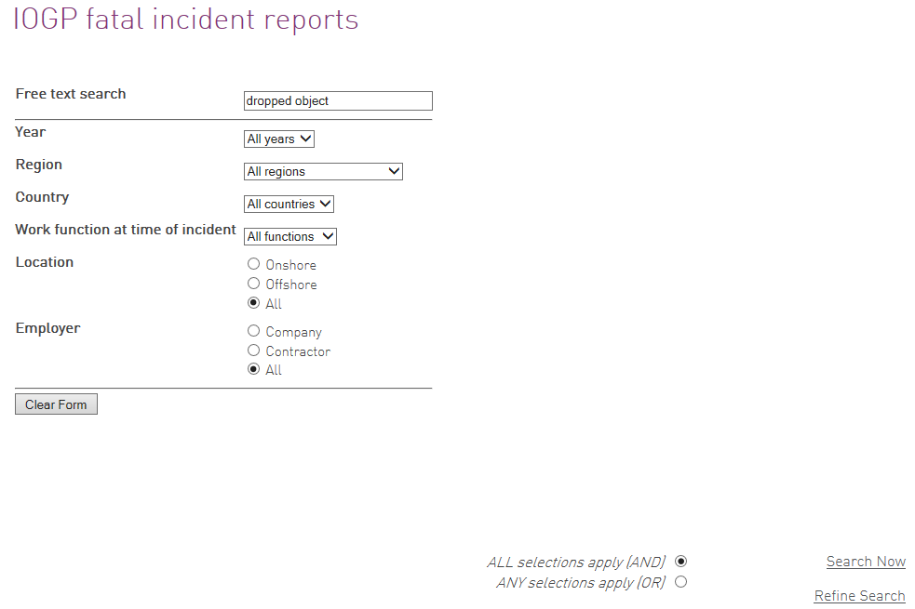
IOGP Safety Zone

Slide 24
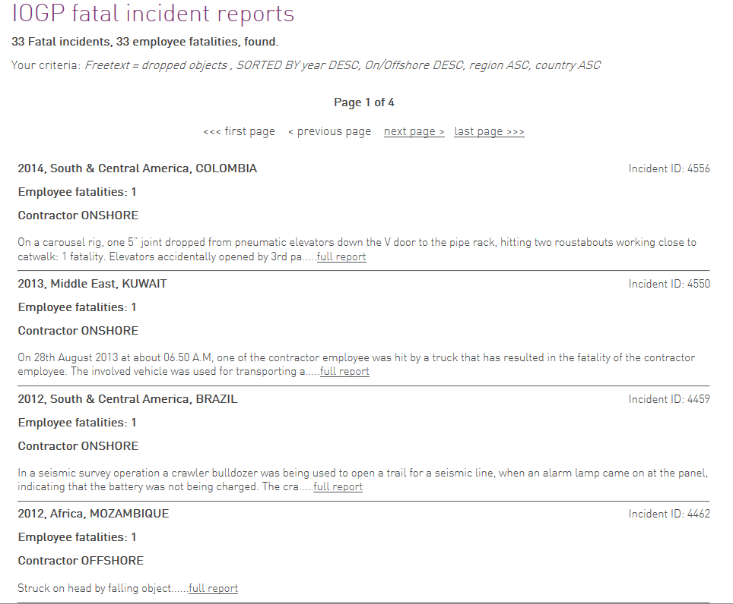
IOGP Safety Zone
Notes:
114 events in the HiPo Database

Slide 25
IOGP
Chris Hawkes – Safety Director
Mariana Carvalho – Health & Safety Committee Manager
Wendy Poore - Data and Web Applications Specialist
Kirsty Walker – Schlumberger – Chair Safety Data SC

