Slide 1

Close Encounters of the DROPS Kind

Slide 2

Industry beyond Drilling and Wells calls for DROPS Best Practice implementation…
Applicable?
Time and Cost?
Material Resources?
Management?
AWARENESS?

Slide 3
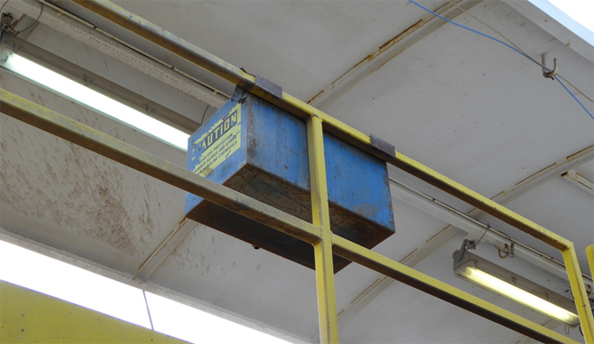
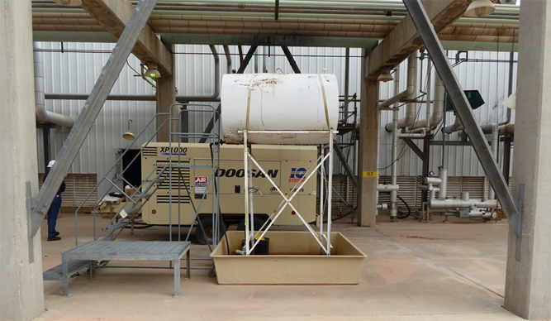
Gravity : A friend or a worksite hazard?
UNDERSTANDING DROPS… STATIC vs DYNAMIC

Slide 4
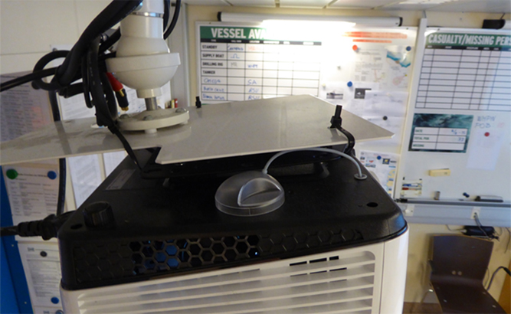
Cable Ties : Rugged, Universal, Low Cost?
SELECTION, APPLICATION, INSPECTION OF FIXINGS

Slide 5

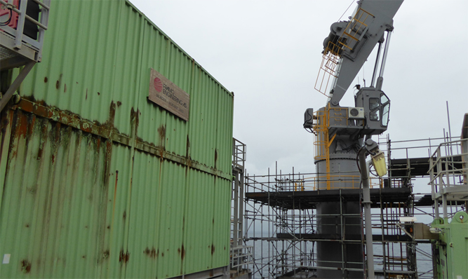
Signage : Functional or Promotional?
REQUIREMENT, DESIGN, APPLICATION, INSPECTION OF ASSETS

Slide 6
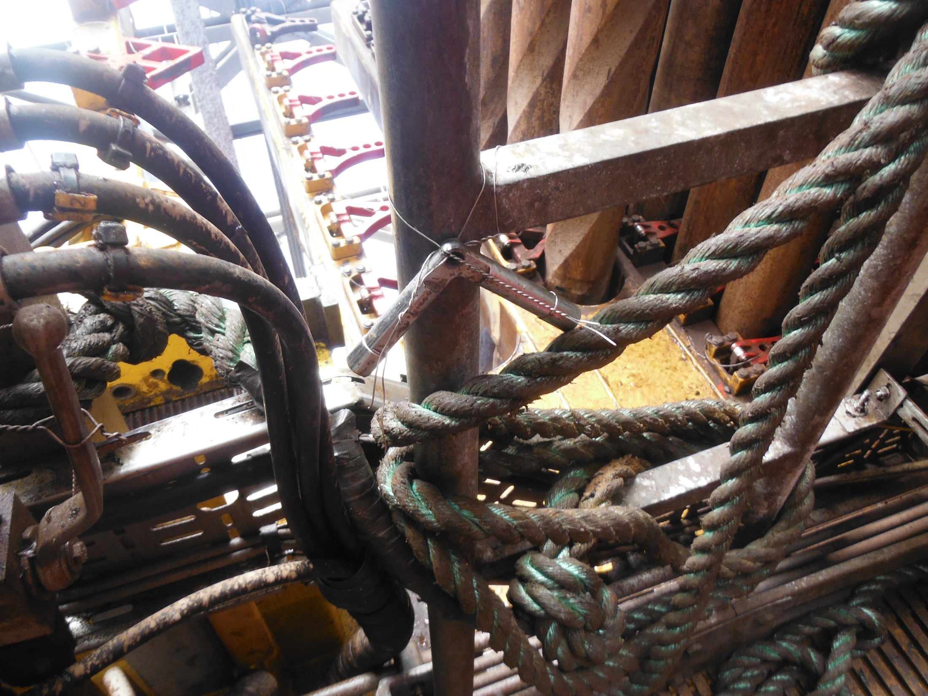
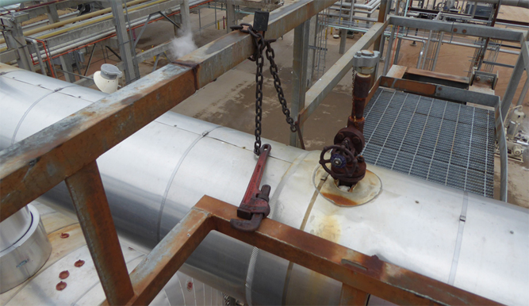
Routinely Used Tools and Devices
INVENTORY, INSPECTION, STORAGE AND SECURING OF ALL TOOLS

Slide 7
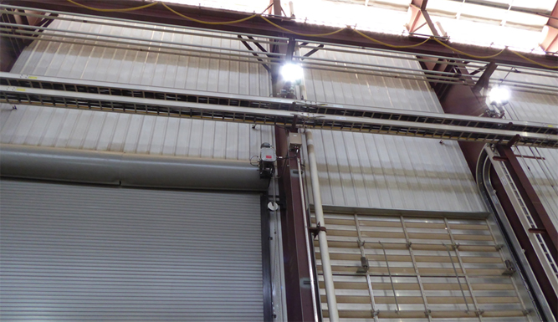
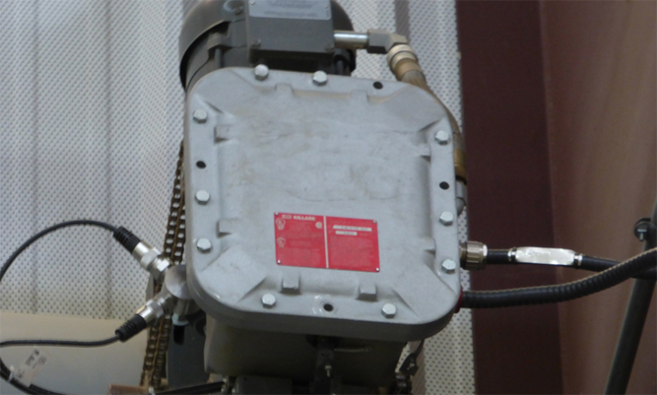
Periodic Maintenance and Handovers
UNDERSTANDING RELIABLE SECURING FEATURES

Slide 8
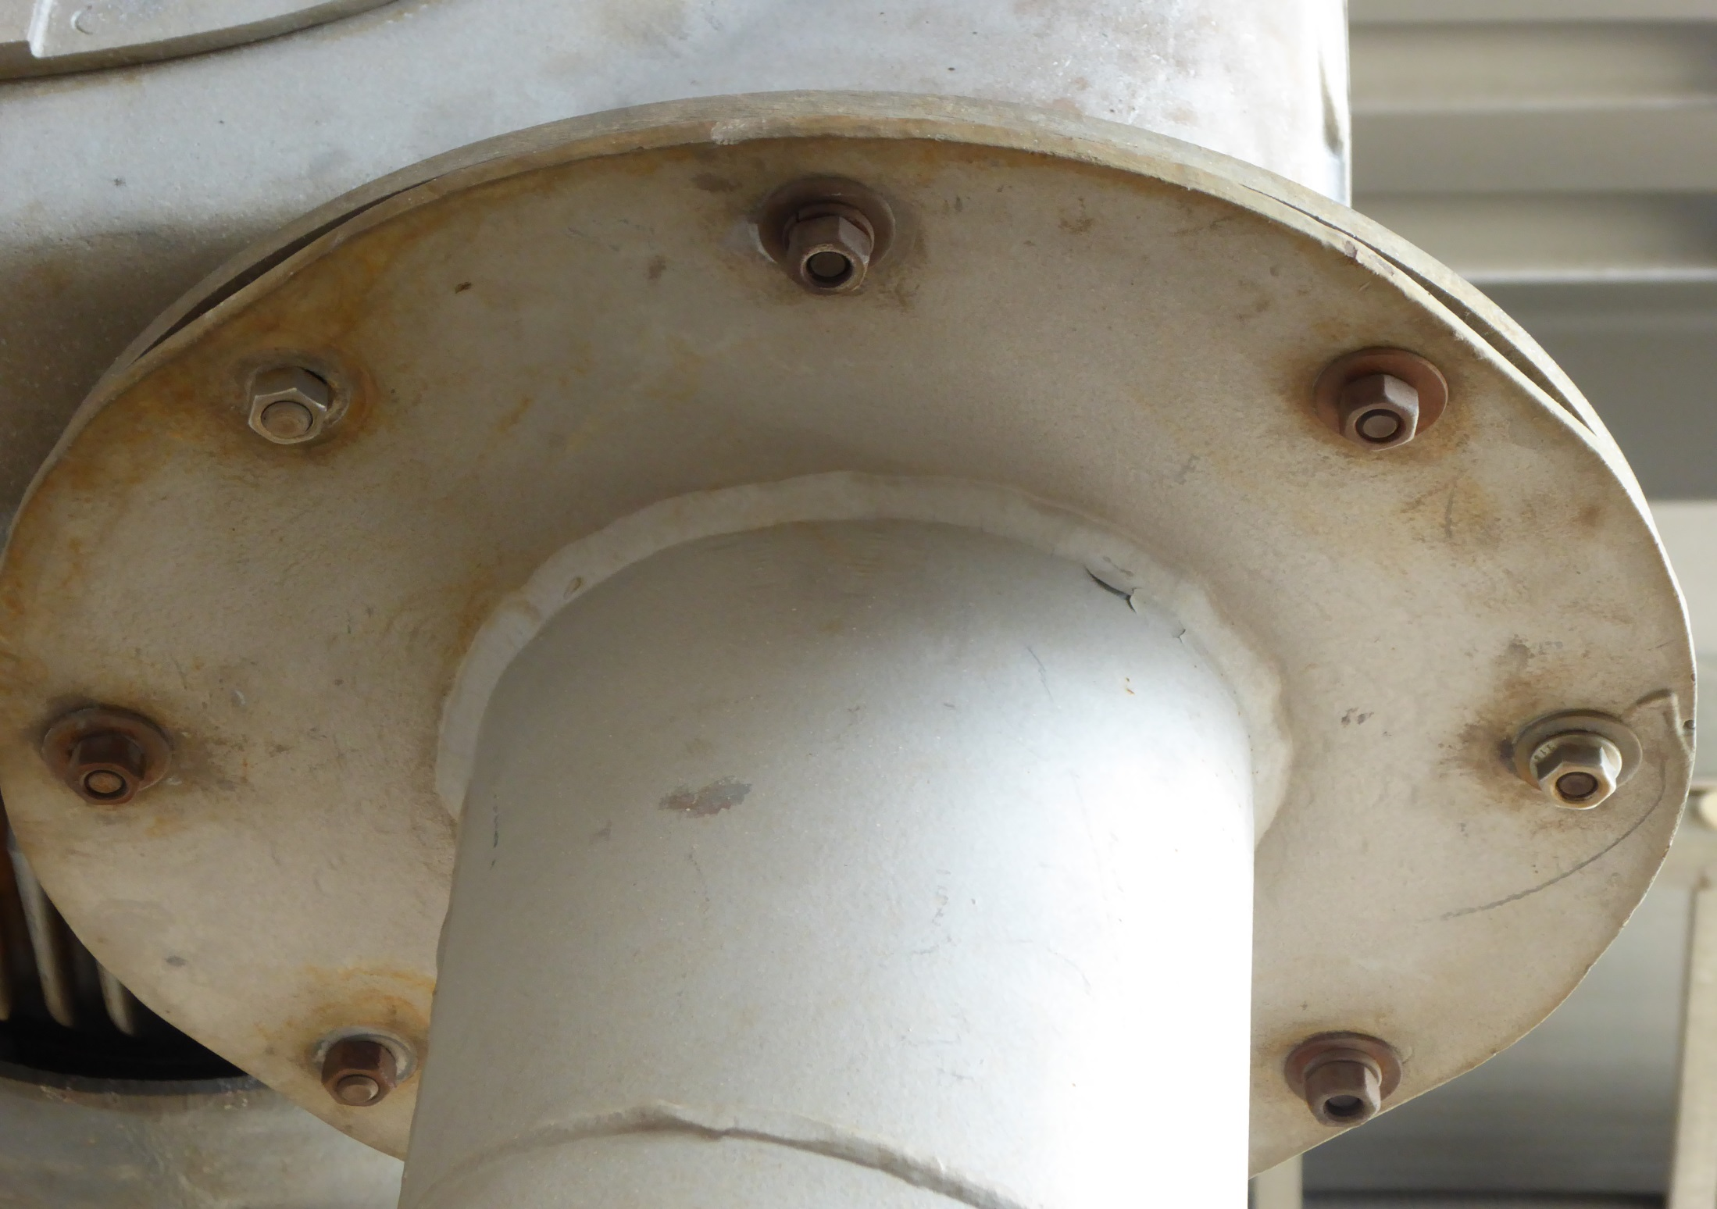
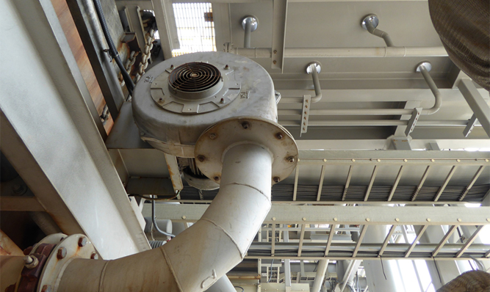
Equipment Overhaul and Replacement
MANAGING RELIABLE SECURING FEATURES

Slide 9
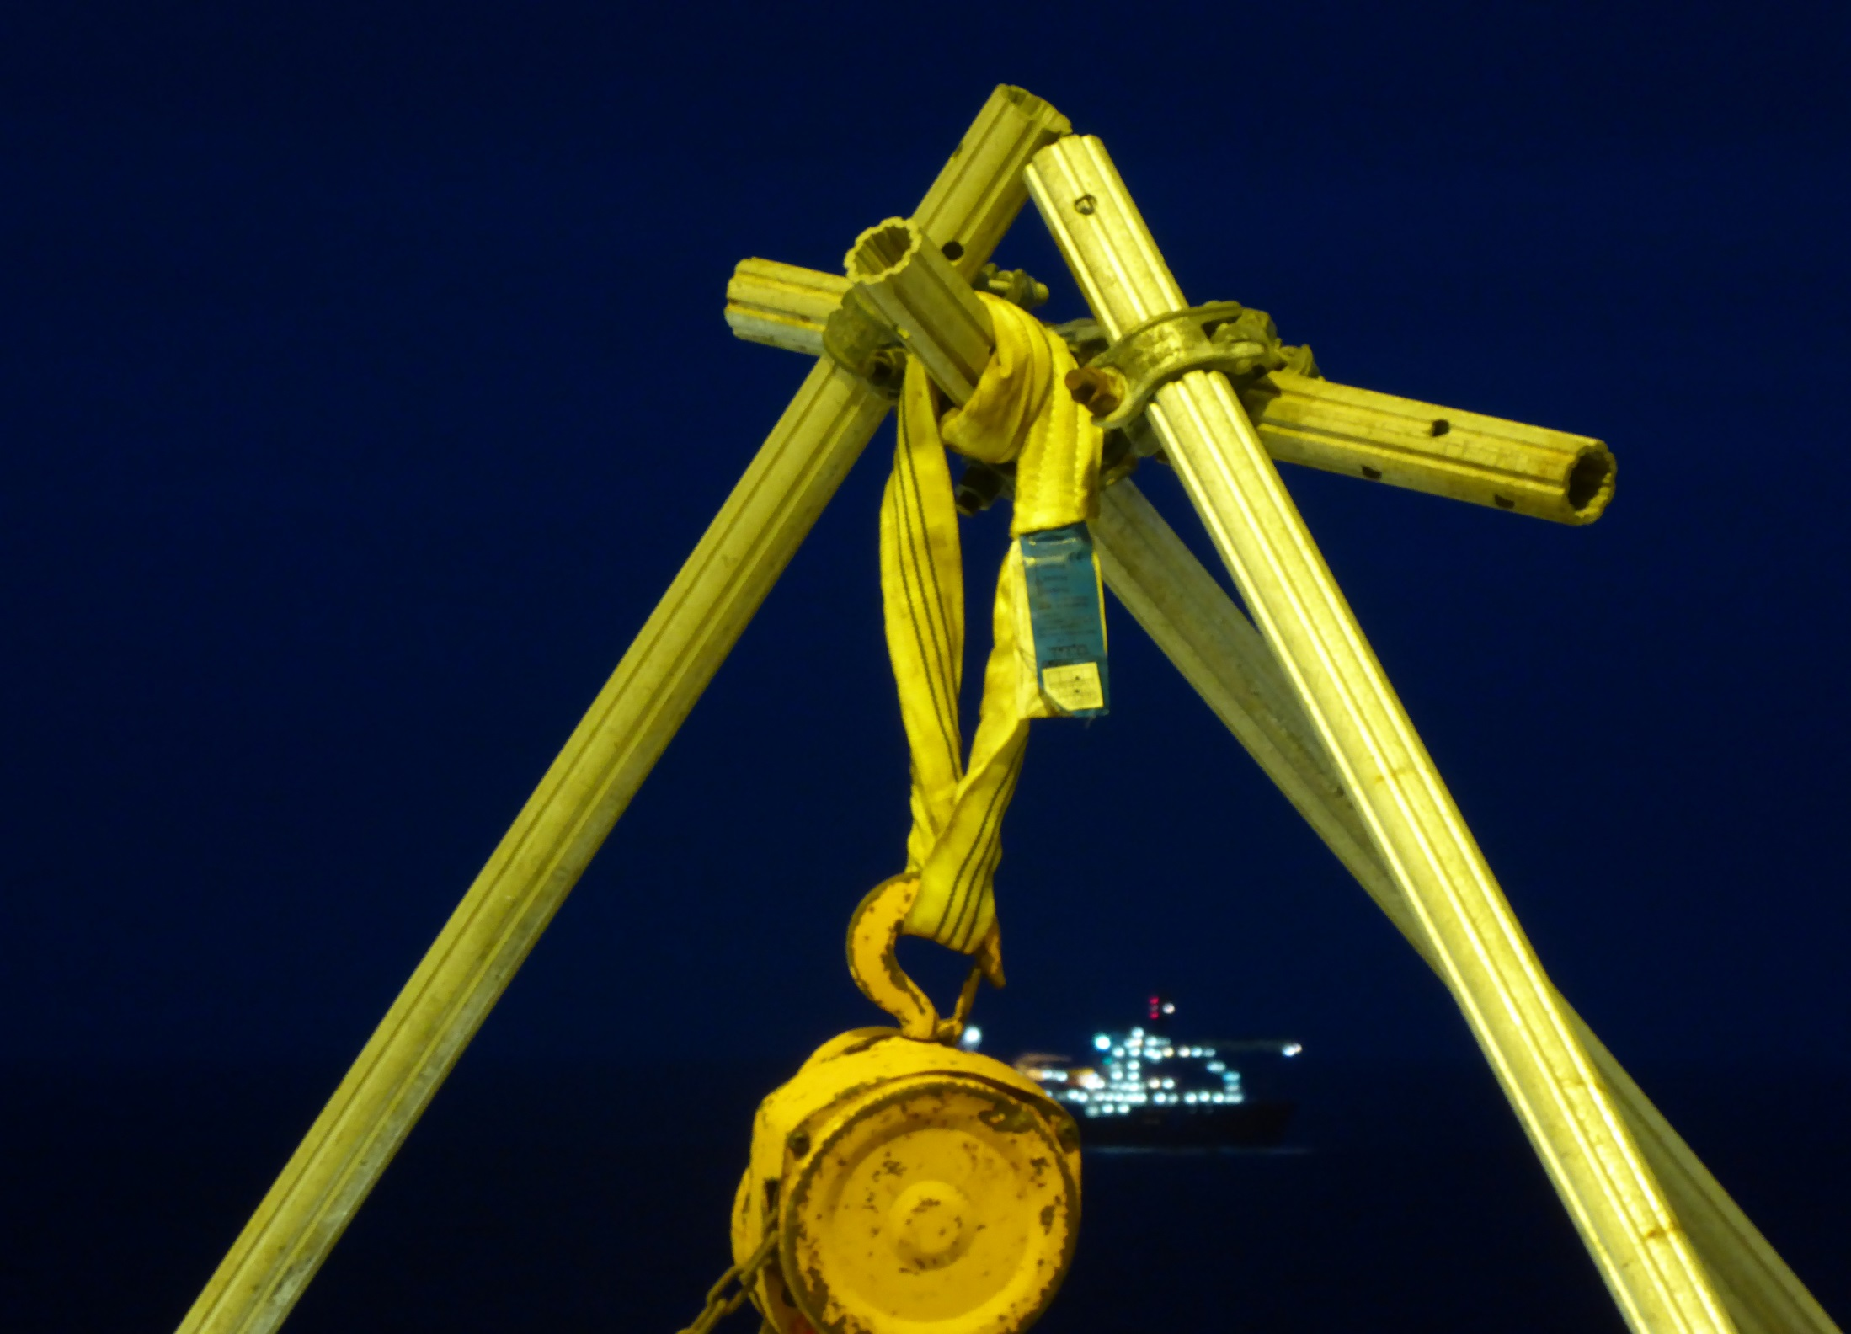
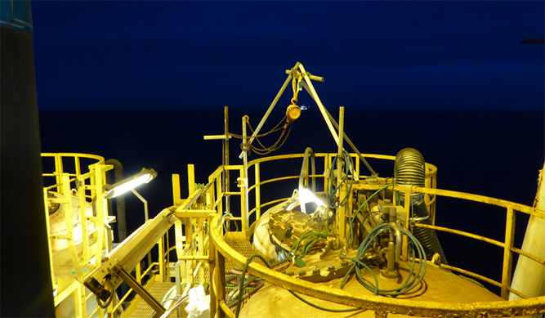
The Ridiculous, to Achieve Simple Objectives
AVAILABILITY OF APPROPRIATE EQUIPMENT AND RESOURCES

Slide 10
  AREA APPLICABLE
  DROPS CONTROLS (preventive and mitigating)
      Primary Fixings and Secondary Retention
      Preventive Maintenance System
      Independent Dropped Object Surveys
      Planned Dropped Object Visual Inspections
      Pre-Task Risk Assessments and Checks
      Management of Change
      Stop the Job, Communication and Drops Vigilance
      Safety Securing
      Restricted Access Areas
FOR EXAMPLE
ONLY
  AREA ZONED ACCORDING TO DROPS EXPOSURE
  CONTINUAL
  INTERMITTENT/ OCCASIONAL
  MINIMAL / NONE
  Work at Height and Lifting Requirements
  APPLICABLE TO ALL AREAS IN ALL ASSETS AND FACILITIES
  Supports existing Work at Height and Lifting Standards
      Tools and Equipment Aloft Log Book
      Securing Tools and Equipment at Height
      Temporary Barricades
      PA / Audible Warnings and Standby Persons
Risk Based Approach
ACTIVITY AND PERSONNEL EXPOSURE IN DROPS RISK ZONES

Slide 11
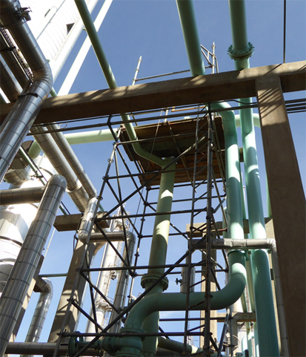
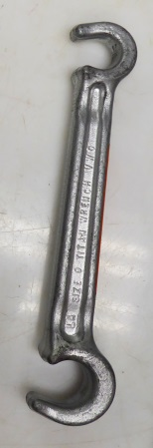

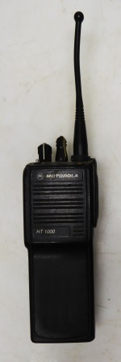
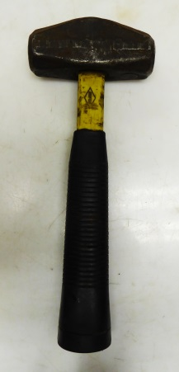
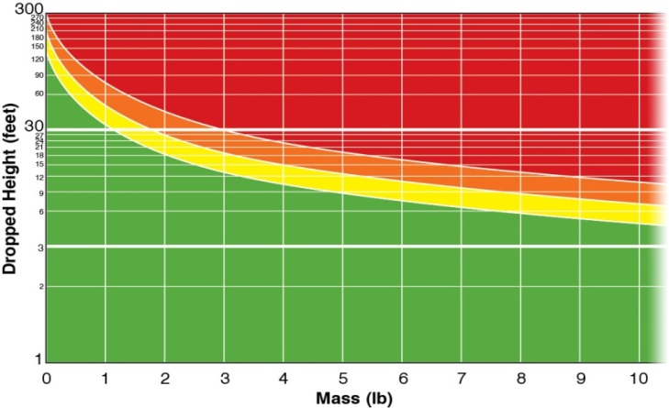
PRE-TASK RISK ASSESSMENT
WORKING AT HEIGHT
All Personnel. All Activities.
Identification of static and dynamic dropped object hazards and risk assessment shall be documented during all Pre-Task activities and JSAs (e.g. tools and equipment at height, collision checks, environmental factors, housekeeping, removal/replacement of equipment at height, concurrent operations and application of DROPS Calculator in the assessment process).

Slide 12
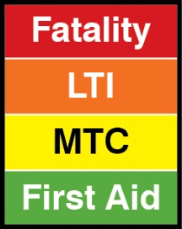

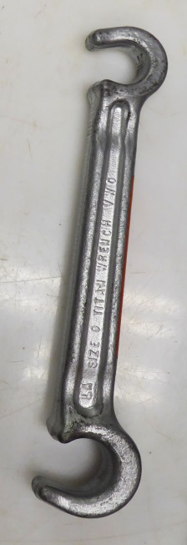
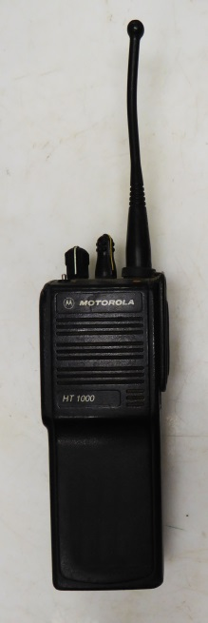

DROPS Calculator
35ft
1 1/4lb
1 1/4lb
1 3/8lb
2 3/4lb
Notes:
Let’s say it falls 4.5m (15ft) on to the deck below after an unexpected shock load after a non-powered descent during lifting. Use the DROPS Calculator to work out the consequence.
>>The DROPS Calculator appears. Discuss the colour coding.
>> Recap on the scenario (Nail bar falls 4.5m after shock load, it weighs 2.3kg)
>>First sliding bar shows weight against the bottom axis
>>Second sliding bar shows height against the side axis. This is an exponential or logarithmic axis so take time to explain how it is read. Consequence = Lost Time Injury – a serious injury that results in a dislocation of a shoulder, fracture of an arm, medivac and some considerable recovery time. Add to this the investigation and associated lost time and money.
Now read the Calculator guidance. If the nail bar had fallen vertically, as it appears here, is there a chance it may puncture the skin? If it fell point-first into the side of the neck, what is the worst that could happen?
There is a chance it would enter the body like a spear.
(In the event that this is queried, show with due care the slide show entitled Fishing the Tool. This shows what can happen to a human body when scaffold poles, downhole tools and anything that has a small or sharp impact point. Note this crew member survived against all the odds).
On the right: Sometimes snagging can result in a dropped object, like this connector on the tank skid. During lifting, this was sheared and it fell to the deck. It weighed 2.75kg and fell 13m to a deck below.
Discuss why this happened. Is it design or is it simply that the last person to use it failed to remove the connector and replace it with a cap? Use the calculator to work out the consequence had it struck someone.
>>

Slide 13
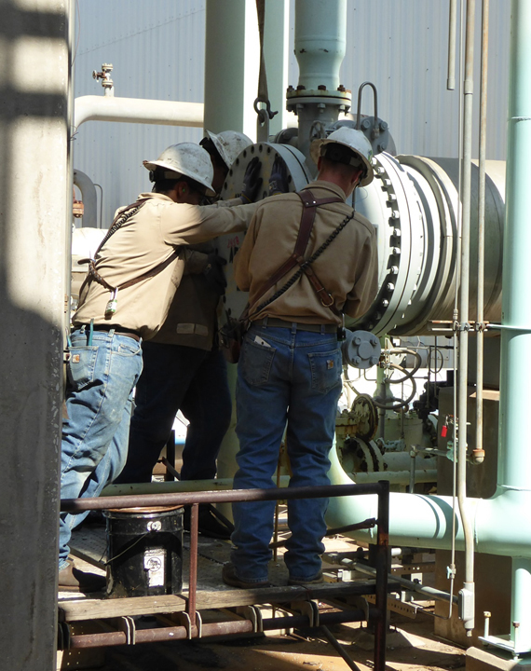
  WORK AT HEIGHT & LIFTING REQUIREMENTS
  In addition to Work at Height and Lifting Standards…
  Tools and Equipment Aloft Log Book
    What’s going up?
    Everything brought back down?
  Securing Tools and Equipment at Height
    Suitable for use?
    Secured against dropping?
    Removed from worksite if not required?
  Temporary Barricades
  PA / Audible Warnings and Standby Persons

Slide 14
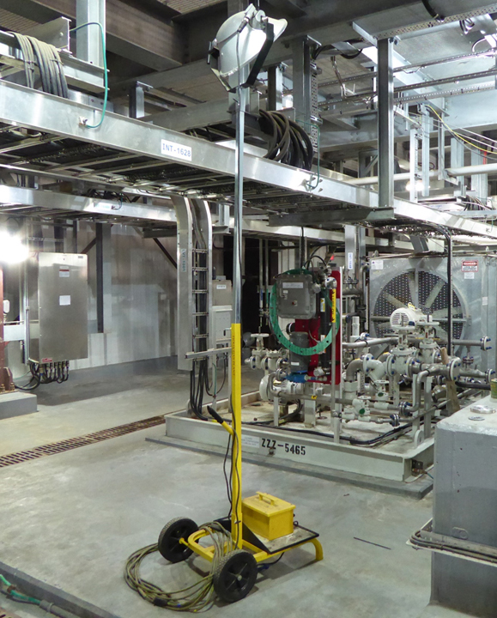
  STOP THE JOB, COMMUNICATIONS AND DROPS VIGILANCE
  Static/Dynamic Potential during any task? Then STOP the Job!
  JSAs – Discuss and Identify Drops Hazards, how they might occur and how they can be prevented
  Toolbox Talks – always include Drops
  Safety Meetings – present findings and incidents
  Hazard Hunts – look for loose, unnecessary items at height or missing fittings, damaged fixtures or equipment.
  GOOD HOUSEKEEPING

Slide 15
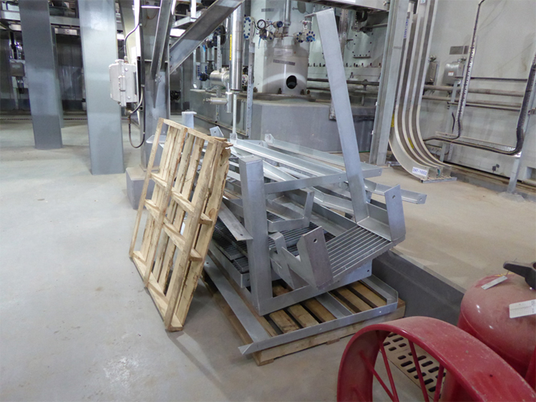
Understanding DROPS is Critical
MANAGEMENT OF DROPS IN ALL DISCIPLINES AND ACTIVITIES

Slide 16


Slide 17


