Slide 1



Slide 2

STATIC DROPPED OBJECTS,
COMMON INSPECTION FINDINGS

Slide 3
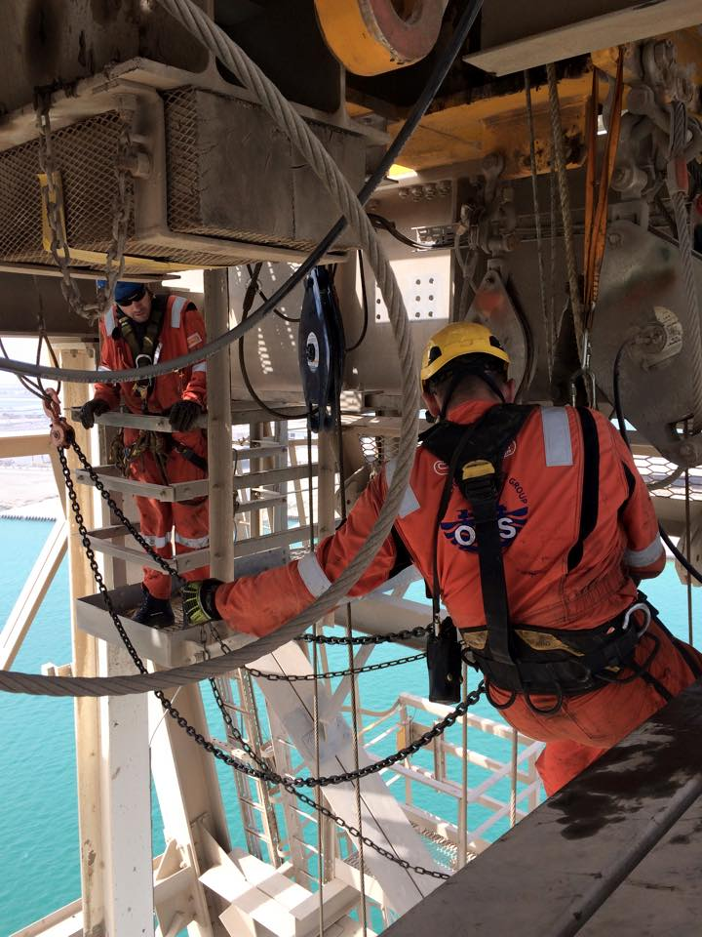
For those who don’t really know us:
OES began operating 20 years ago.
We provide a range of specialist inspection services backed up with excellent reports.
We operate globally, supporting our clients from 12 offices worldwide with a team of 200+ inspection personnel

Slide 4

OES’ Dropped Objects Solution Suite:
We provide various types of dropped objects surveys and services:
DOPP (Dropped Objects Prevention Programme):
  Analysis of clients dropped objects procedures and culture
  Tailored procedure rectification.
  Tailored training in static and dynamic dropped objects awareness
  Conduct a dropped objects survey and create a tablet based dropped objects solution with RFID integration
  Training in conducting DOPP surveys with the tablet

Slide 5


OES’ Dropped Objects Solution Suite:
Dropstrack
  Thorough dropped objects surveys via rope access (where needed) to hunt down potential dropped objects
  Work with our clients to rectify findings
  Dropped Objects surveys with full crew packs for follow up
Dropped Objects E-learning Programme
On-site and off-site Dropped Objects training

Slide 6
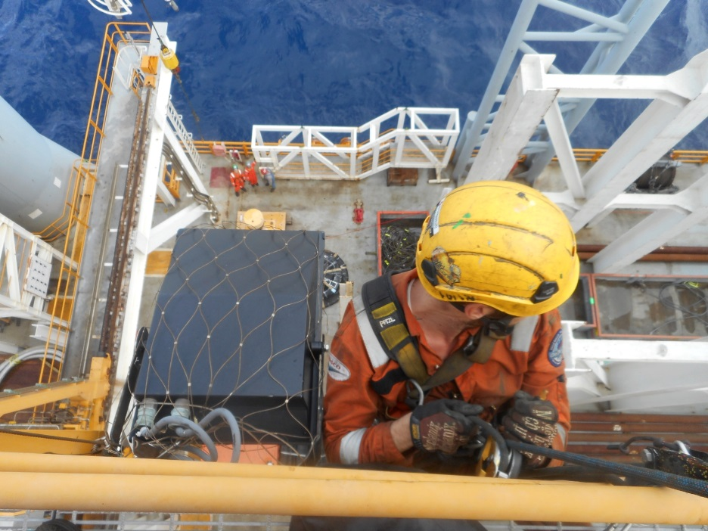
Some OES related numbers:
In the last 10 years we have conducted 1,775 dropped objects surveys, finding hundreds of thousands of potential dropped objects and then helping our clients to rectify them for a safer work place.
As an example of how many potential dropped objects there are to find out there; in 2015 on the 173 rigs we conducted dropped objects surveys on, we found 50,405 potential dropped objects.
Dropped objects we classed as “critical” in their severity over the last 10 years, were on 916 unique types of equipment.

Slide 7
Serial offenders in “Critical” action items

Slide 8
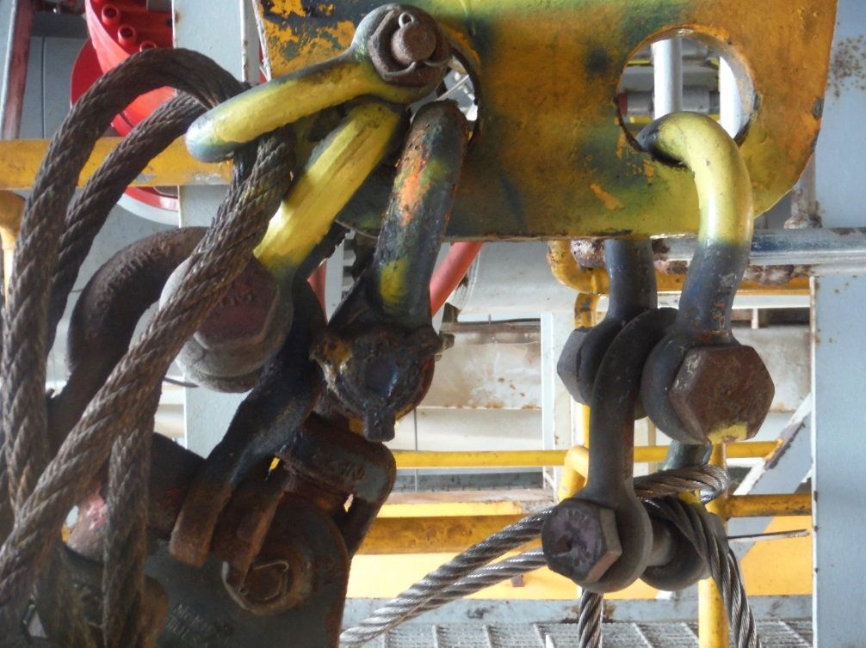
In 5th Place - Sheave blocks
Incorrect type of sheave block
Incorrect type of shackle
Incorrect safety pin
Lack of, or inadequate, safety securing
Damage/Corrosion

Slide 9
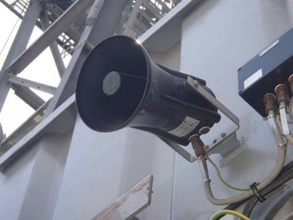
In 4th Place – Loudspeakers
Lack of, or inadequate, secondary retention
Lack of, or inadequate, safety securing
Incorrect use of safety sling
Incorrect type of carabineer used on safety sling

Slide 10
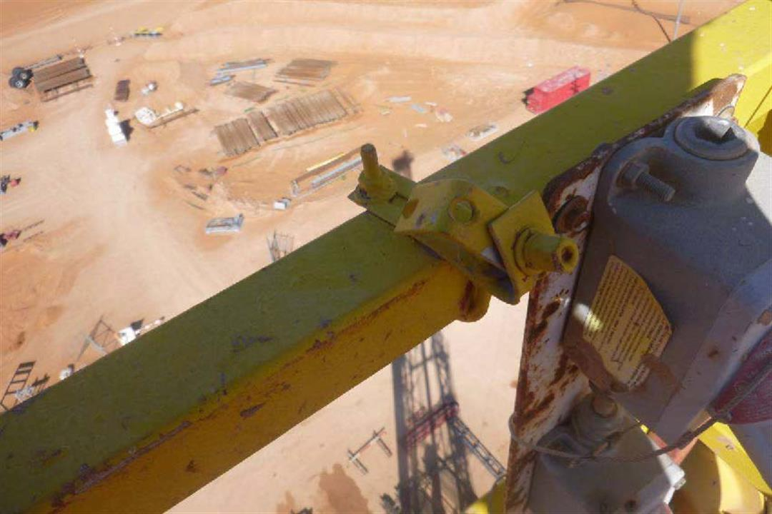
In 3rd Place – Redundant equipment
Unnecessary loose lifting equipment in the derrick
Poor housekeeping
Unnecessary brackets and clamps
Tools and equipment left in the Derrick

Slide 11
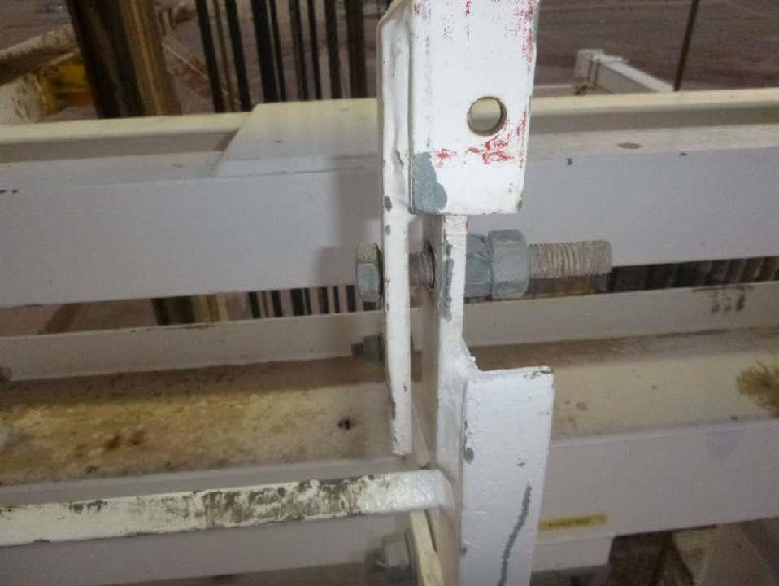
In 2nd Place – Ladders
Missing / Loose Bolts
Damage / Corrosion
Lack of, or inadequate, secondary retention
No fall protection system

Slide 12
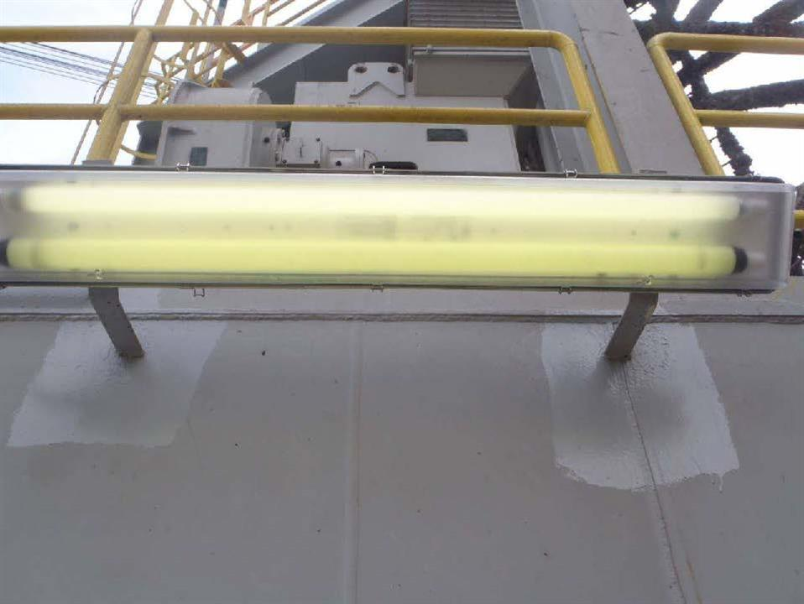
In 1st Place – Strip Lights
With nearly 3 times the findings of anything else
Lack of, or inadequate, secondary retention
Lack of, or inadequate, safety securing
Incorrectly attached safety sling
Incorrect type of carabiner used on safety sling

Slide 13
Although those are some of the most frequent findings from our surveys, they are often not the actual dropped object cases that take place.
Dropped objects are often related to the actions of personnel.

Slide 14
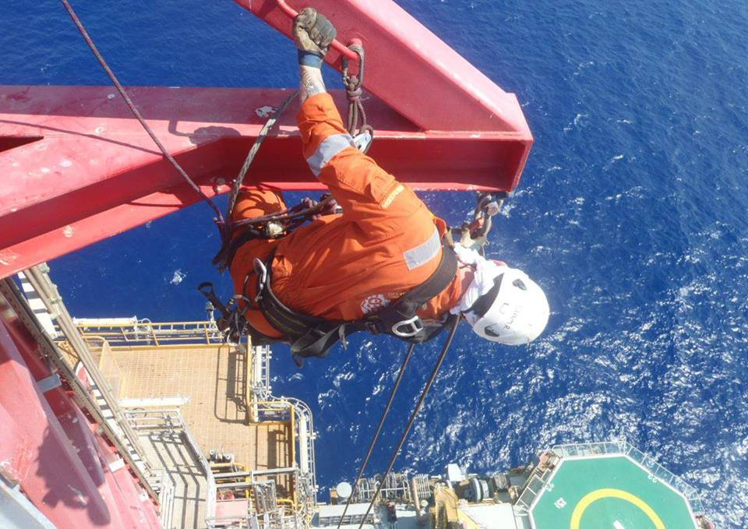
Some examples:
Incorrect selection of hand tools for working at height
Poor placement of equipment parts when carrying out maintenance
Falling objects from rotating equipment, such as Top Drive, often due to incorrectly reassembled equipment (e.g. not replacing locking wires)

Slide 15
Some basic measures to further mitigate dropped objects
A good understanding of dropped objects by the rig crew (training)
  Rig crew conducting meaningful Drops surveys with a solid understanding of what to look for and how to rectify findings
  JRA’s / JSA’s conducted with Dropped Objects considered
Providing the right tools for work at height and ensuring the crew can easily locate and access them
Relocating equipment that is in a strike path and therefore at dynamic risk to a better location without hindering functionality (e.g. a loud speaker that is within striking distance crane boom and/or load).
Selecting a good 3rd party to setup your dropped objects program
Heightened awareness and culture around not leaving unnecessary equipment in the Mast / Derrick

Slide 16
QUESTIONS?

Slide 17
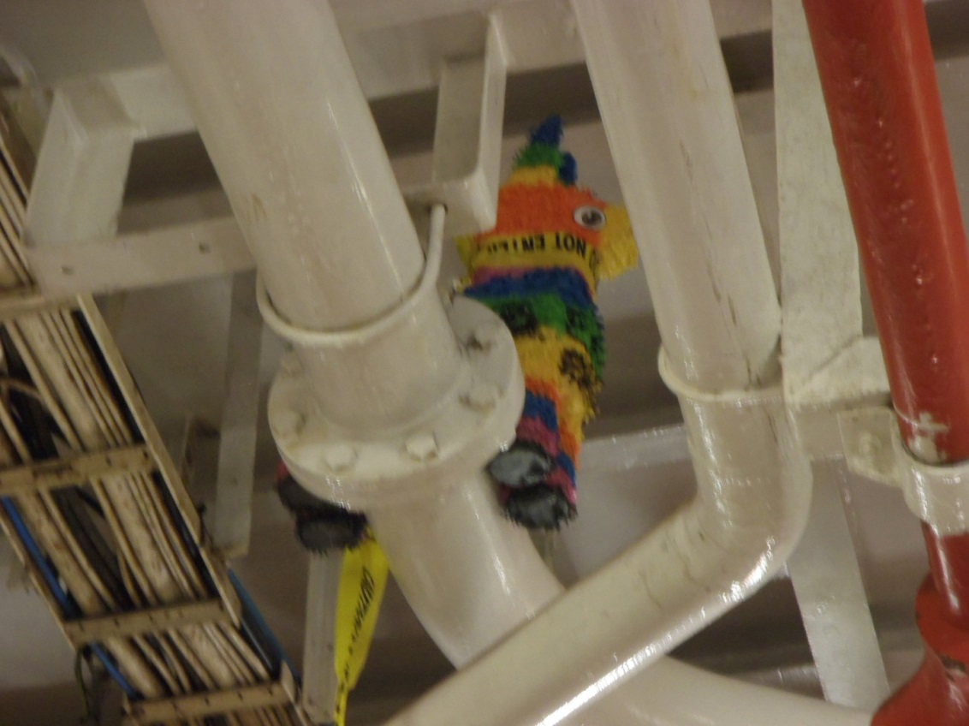
We find all sorts of redundant items at height:

Slide 18






THANK YOU
www
oesgroup.com
CONNECT WITH OES

