Slide 1

Identification & Elimination of High Potentials
Lessons Learned -
Discussion

Slide 2
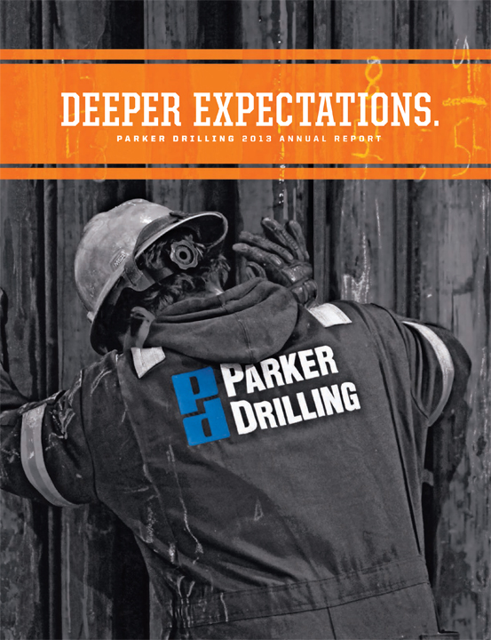
Commitment to Safe Operations
  Our Vision:
  No incidents
  Our Priority:
  Incident free operations; where nobody gets hurt, without harm to the environment or assets

Slide 3
Progression of a Safety Culture
‘70s, Signing of the Occupational Safety and Health Act, OSHA Established
Unaware
“We’re OK but accidents do happen”
Reactive
“Safety is important. We fix problems after every accident.”
‘80s, Introduction of Workers Right to Know about Industry Hazards
Systematic
“We have systems in place to manage recognized hazards.”
‘90s, Management systems formalized, SHACS, Tightening of Rules
Proactive
“We methodically anticipate problems before they occur.”
‘00s, Technology, Ergonomics, Dust explosions Employers must pay for PPE
‘10s, Process & Systems, Hazard & Risk Assessment, Near Miss Reporting
‘70s
‘80s
‘90s
‘00s
‘10s
‘20s

Slide 4
Commitment to Continual Improvement
We are committed to continual improvement, where every employee, including leadership is charged with capturing and sharing knowledge gained from daily challenges and successes.
Process & Systems, Hazard & Risk Assessment, Near Miss Reporting; What’s Next?
  Human Behavior
  Competency
  Process and Procedures

Slide 5
High Potential Incidents by Causation
Dropped Objects:
DROPs are related to 60% of High Potentials
Yet, account for only 7% of Recordable Injuries
High Potentials are investigated using Root Cause Analysis
Corrective Actions are applied and Lessons Learned shared

Slide 6
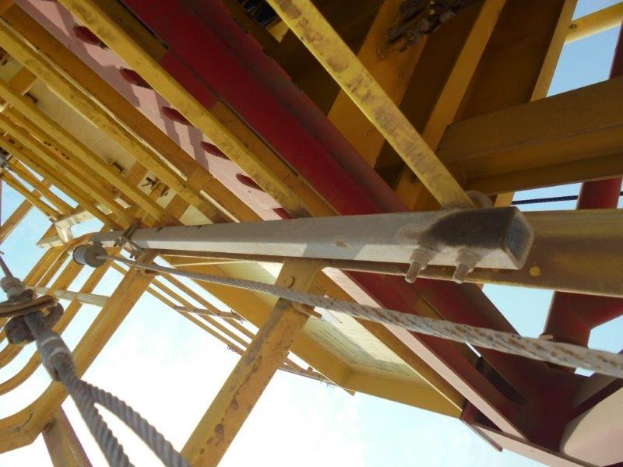
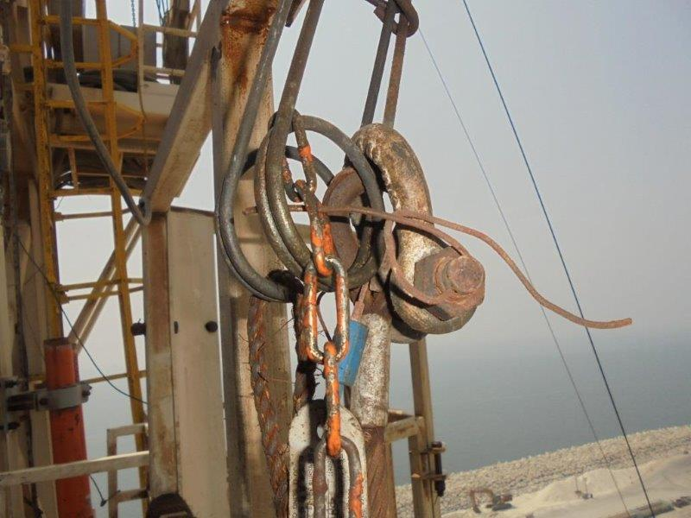
Case Study: Hazard Identification
Recognize the Hazard:
Staff conducted DROPs inspection and identified 4 unsafe conditions
Senior Manager conducted validation inspection and identified 53 unsafe conditions
Equipment incorrectly installed.
Bolts without cotter pins for secondary retention
Welding rod used as safety pin.
Improper configuration
Understand the Risk:
Likelihood that the Hazard can cause serious harm or injury
Control the Risk:
Make changes necessary to prevent the Hazard from causing harm to employees

Slide 7
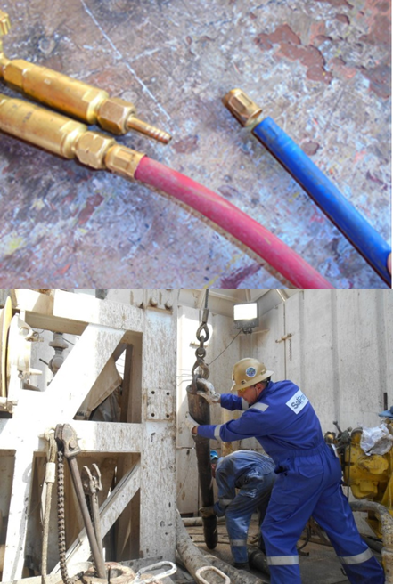
Majority of Injuries not DROPs Related
Most common causes of injuries:
Personnel exposure: caught between and struck by an object
How do you think workers get into position of exposure?
How do we currently mitigate the hazards that cause injuries?

Slide 8
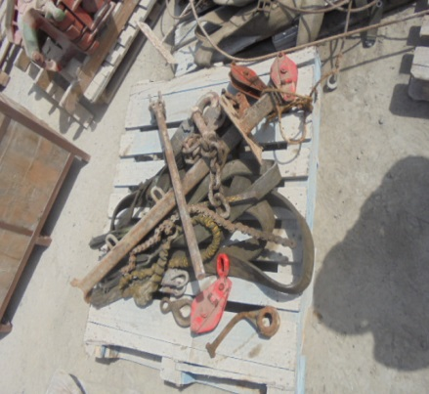
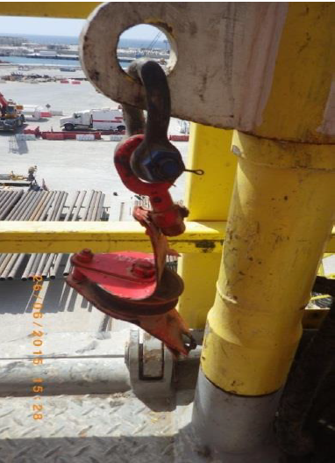
Case Study: Elimination of High Potentials
Recognize the Hazard:
Routine vs Non-Routine operations
Lay down of drill pipe, became non-routine and the associated hazards not recognized by the floor men
Understand the Risk:
Assess likelihood lead blocks will be utilized on location and the resulting exposure to injury
Control the Risk:
Equipment identified as hazardous removed from site

Slide 9

Safe Management of Operations
Instilled Safety Culture
  Maintain awareness of the big picture while focusing on the details of the planned routine task at hand
Human Behavior (awareness of human weakness)
  Concentration span with repetitive work – Job rotation
  Complacency – Constant reminders and messages
  Distraction – Teams often concede a goal after scoring
Validation through Competence
Assurance with an emphasized
focus on Short Service Employees

Slide 10
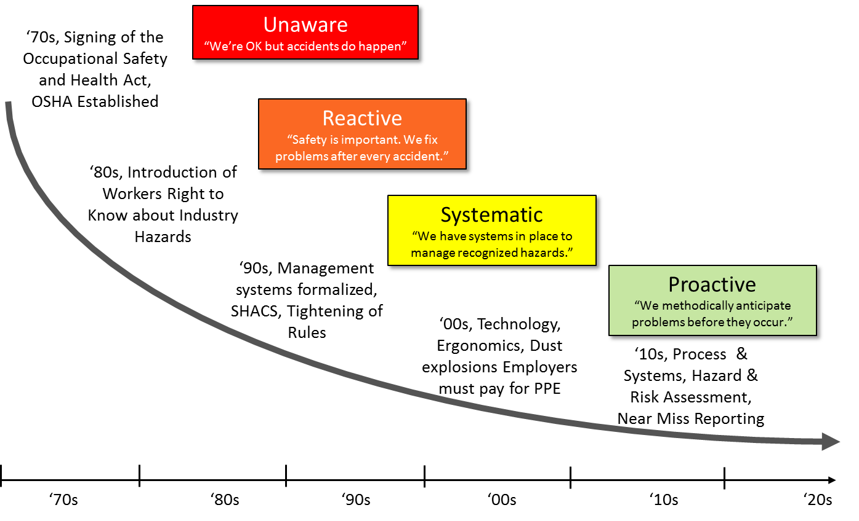
Our Expectations
Identification and elimination of hazards that escalate in severity when routine work becomes non-routine will drive continuous safety improvement
Sharing Lessons Learned on a more granular level with greater cooperation will benefit the industry
Hazard Identification
  Recognize the Hazards
  Understand the Risks
  Change to prevent Harm

Slide 11
Identification & Elimination of High Potentials
Lessons Learned

