Slide 1


Slide 2
Alternative Securing Devices: Four-part Shackles
Alternative securing devices for 4-part shackles.
Member and client fully support use of split pin for shackles on permanent / dedicated fixture points, rigging assemblies, items at height, etc
They are finding their use cumbersome on frequent use ‘pick and place lifts’, more so with the introduction of High Impact Gloves
The options of having to remove gloves to install the split pins or fitting a more user friendly securing pin during a ‘pick and place lift’, are both presently considered unacceptable
Member and client are seeking advice and feedback on acceptance for alternative devices, including items they are trialling and any other alternatives known by the DROPS community

Slide 3
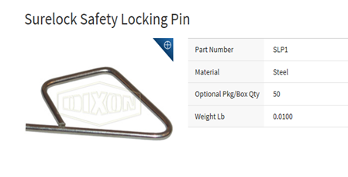
Alternative Securing Devices: Four-part Shackles

Slide 4
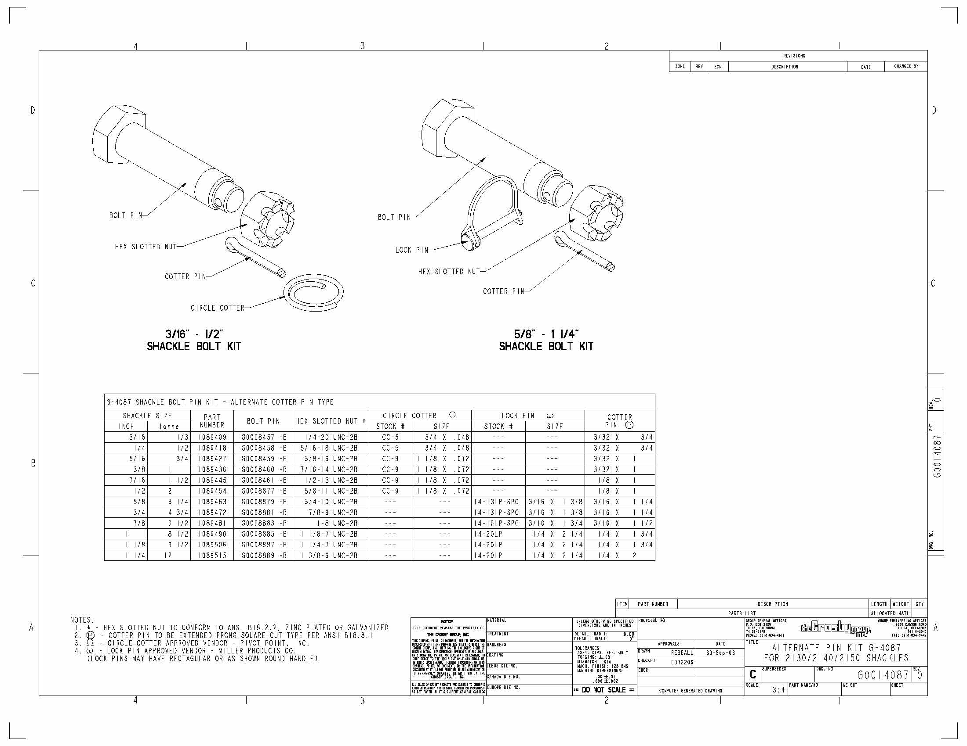
Alternative Securing Devices: Four-part Shackles

Slide 5
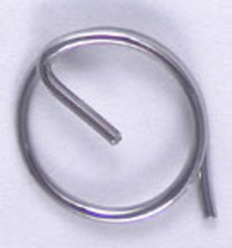
Alternative Securing Devices: Four-part Shackles
Cotter Ring

