Slide 1
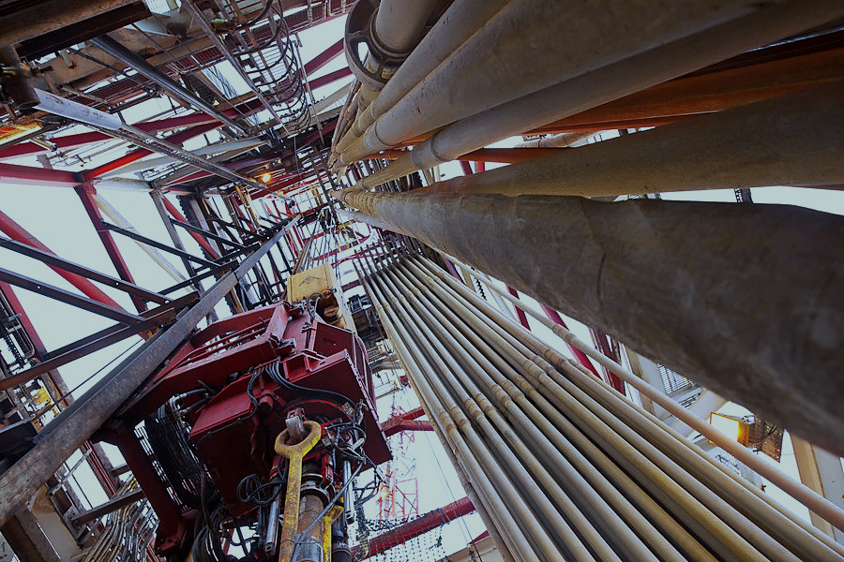

Learning from Incidents
80/90ft Wireline Mast Column Stop Plate falls 65ft / 19.8m (HiPo)
Published by DROPS (Dropped Object Prevention Scheme) JUNE 2025

Slide 2
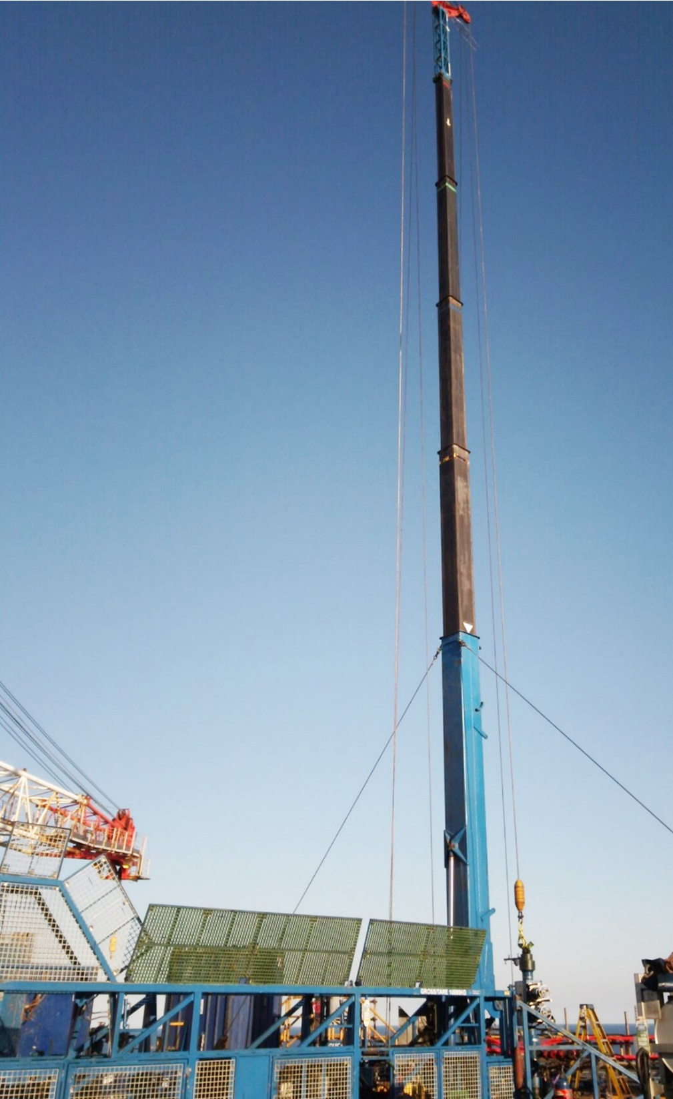
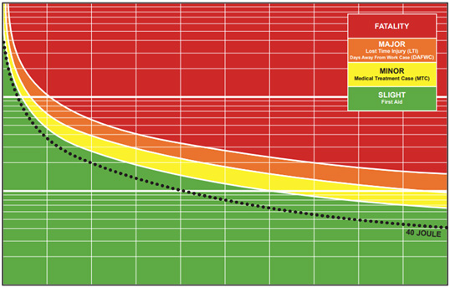
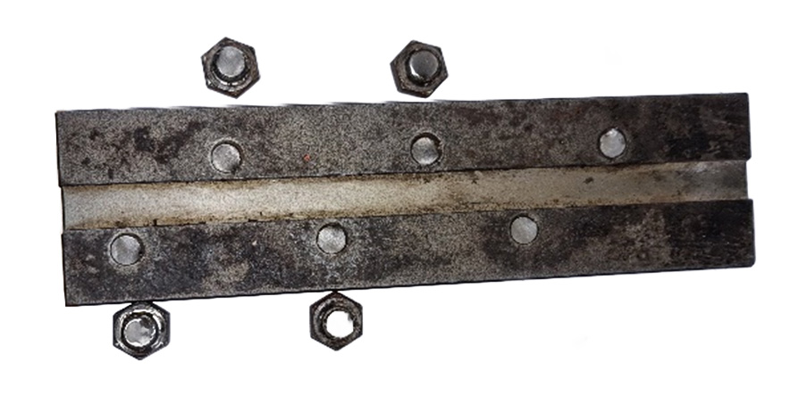
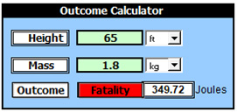
Incident Summary
As the 90ft Wireline Mast was rigged up in preparation for operations, a dropped object was reported within the restricted access area.
The area was secured and a sweep of the worksite performed, leading to the discovery of a mast column stop plate and four sheared 12mm HEX bolt heads, with a further 2 bolt heads later identified.
GREEN
MAST SECTION
The stop plate weighing 1.8 kg had become detached from its position (green mast section shown on right) and dropped 19.8m / 65ft to deck.
STOP PLATE (25cm x 6.5cm x 1.5cm) & BOLT HEADS
LEARNING FROM INCIDENTS

Slide 3
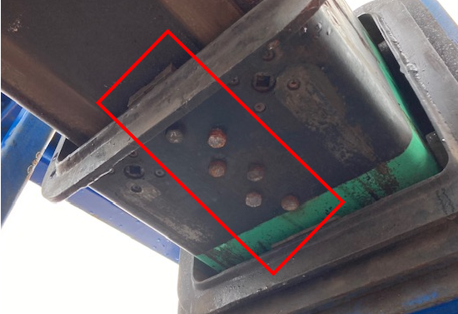
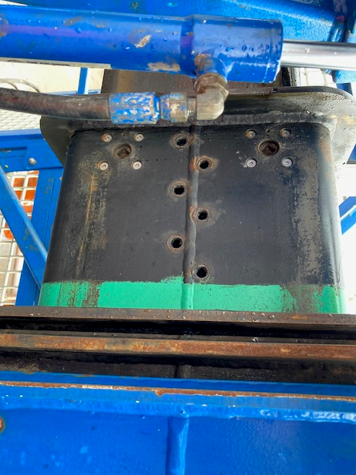
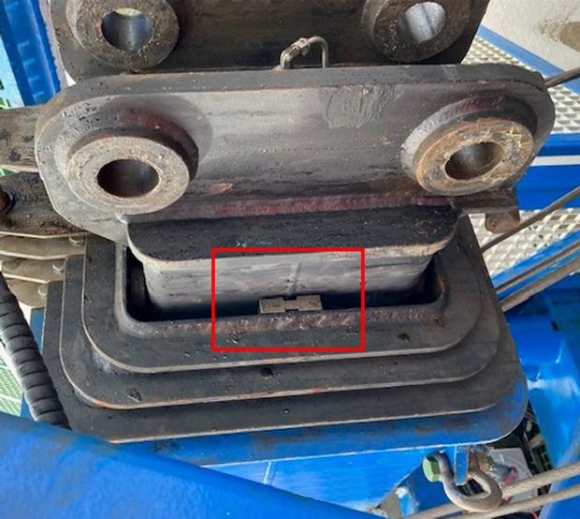
Incident Summary Images
Underside stop plate correctly installed. Torque of bolts was checked at the time of visit and found to be correct
Stop Plate fell from the ‘green’ mast section which had been extended to ~65ft / 19.8m
Other stop plate correctly fitted with around 2mm of clearance.
LEARNING FROM INCIDENTS

Slide 4
Causal Factors
The stop plates are installed as a safety measure to prevent the mast outer column section from being over-extended beyond the design criteria and to maintain mast stability during operation.
The stop plate that dropped was found to be orientated incorrectly during servicing which can be attributed to:
Design of plate enabled incorrect orientation;
Lack of awareness of potential (no precedent);
No clear maintenance procedure for stop plate installation during major servicing of mast.
The end (green) column is the only column to have 4 stop plates in place. These are secured to the column section each with 6 x 12mm grade 12.9 Carbon Steel bolts.
The blue and yellow columns only have 2 stop plates and are of a different design and cannot be fitted in any other orientation.
4 STOP PLATES
2 STOP PLATES
2 STOP PLATES
LEARNING FROM INCIDENTS

Slide 5
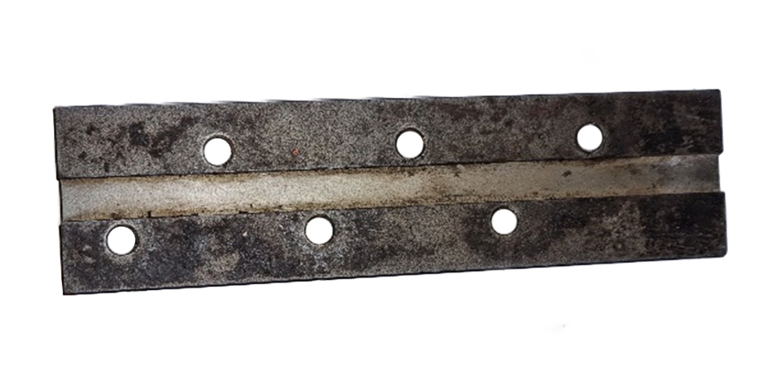
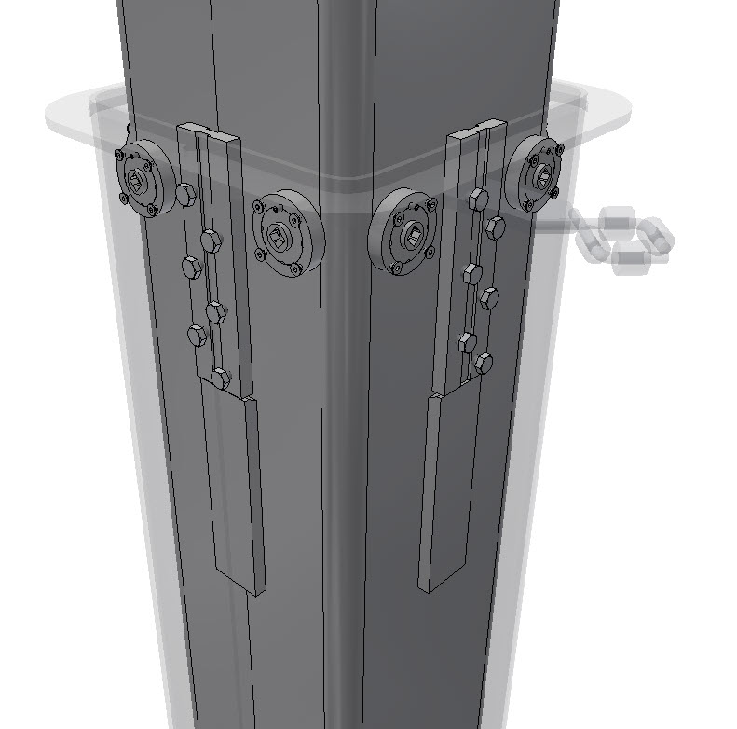
Design (Error Trap)
(Bottom)
(Top)
MAST COLUMN
A = 13mm
B = 48mm
STOP PLATE
When installed correctly, distance A would have been at the bottom of the stop plate whilst the mast was in an upright position.
Due to the incorrect orientation, distance B was at the bottom of the plate, leading to a 35mm difference between the incorrectly installed plate and the other 3 plates (which were correctly orientated).
Correct Installation
LEARNING FROM INCIDENTS

Slide 6
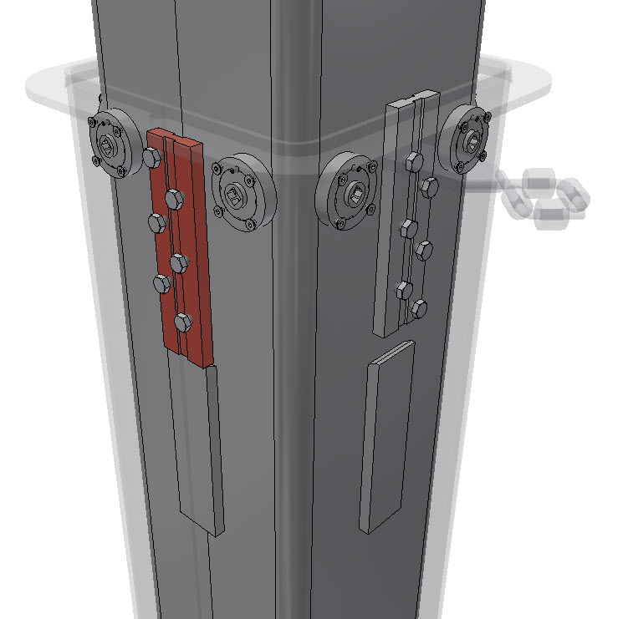
Design (Plate Orientation Error Trap)
MAST COLUMN
MAST COLUMN
In the incorrect orientation, the plate sits 35mm lower than the other 3 plates on this column.
Due to this, when the mast is erected this stop plate is being impacted alone, without the other 3 being in contact.
35mm was the distance that the telescopic cylinder travelled when the bolts sheared.
In the correct orientation the plate sits flush with the section collar.
In the incorrect orientation it sits below the collar level (by 35mm).
Incorrect Installation
Correct Installation
LEARNING FROM INCIDENTS

Slide 7
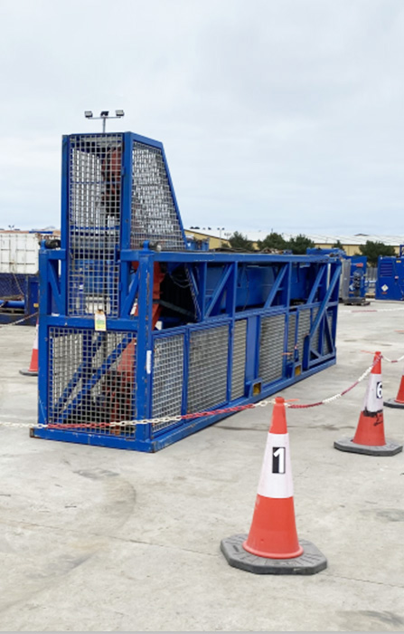
Mast History
90ft (80ft with Jib extension) telescopic WL mast entering service in 2015.
Mast re-entered service following last major survey in 2021. Since that time, the unit has been mobilized on 7 occasions.
One month prior to the incident, pre-mobilisation maintenance checks were completed on the mast before it was mobilised in preparation for operations.
During Operations the mast had been rigged-up, and function tested prior to the incident occurring.
On the day of the incident, with the mast fully erected, one of the mast column stop plates (top column, approx. 65ft from deck level) was heard to fall to the deck below, with all 6 securing bolts sheared.
An immediate STOP was called to operations.
The mast was safely lowered, packed away and returned to shore for immediate quarantine.
LEARNING FROM INCIDENTS

Slide 8
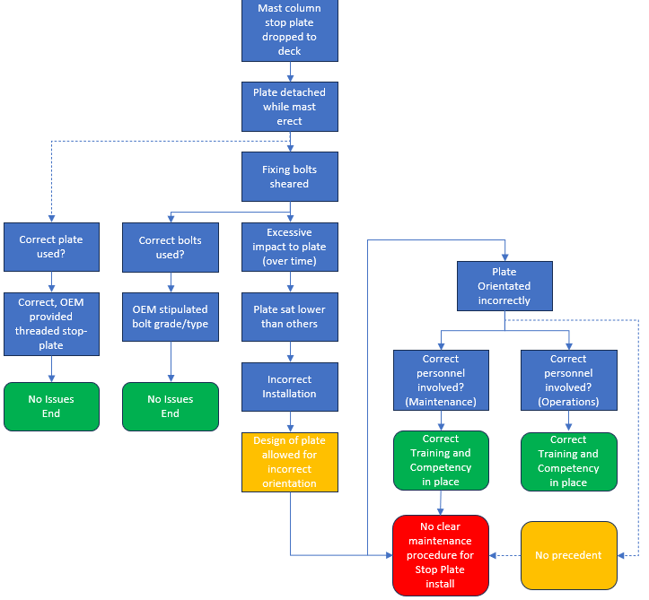
Root Cause Analysis
LEARNING FROM INCIDENTS

Slide 9

Key Facts
COLUMN PRESSURE
Correctly set (2,400psi). Confirmed on site at time of incident.
PERSONNEL
All personnel certified and verified as competent in all aspects of Operations, Maintenance and Training.
OEM INPUT
No shear stress or bearing stress would be transmitted under normal installation and use.
Not aware of any previous similar occurrences.
METALLURGICAL TESTING AND ANALYSIS
Confirmed securing were 12.9 grade Carbon Steel M12 Hex, this aligned with the manufacturer's recommendations.
Both bolt and plate shear directions were approx. 180 degrees different from the expected force direction of the plate when installed correctly.
LEARNING FROM INCIDENTS

Slide 10
Key Facts (Documentation)
CONFORMITY
All certificates available and in date.
Thorough lifting examination performed prior to mobilization.
MAINTENANCE AND INSPECTION
All documents in date and aligned with job history.
RIG-UP AND DROPS CHECKS
Completed and verified, included checking column sections as mast was scoped out.
EQUIPMENT OPERATIONS AND MAINTENANCE MANUALS
Last revision 2019.
Several separate equipment and parts drawings.
No clear detail on stop plate installation contained.
LEARNING FROM INCIDENTS

Slide 11
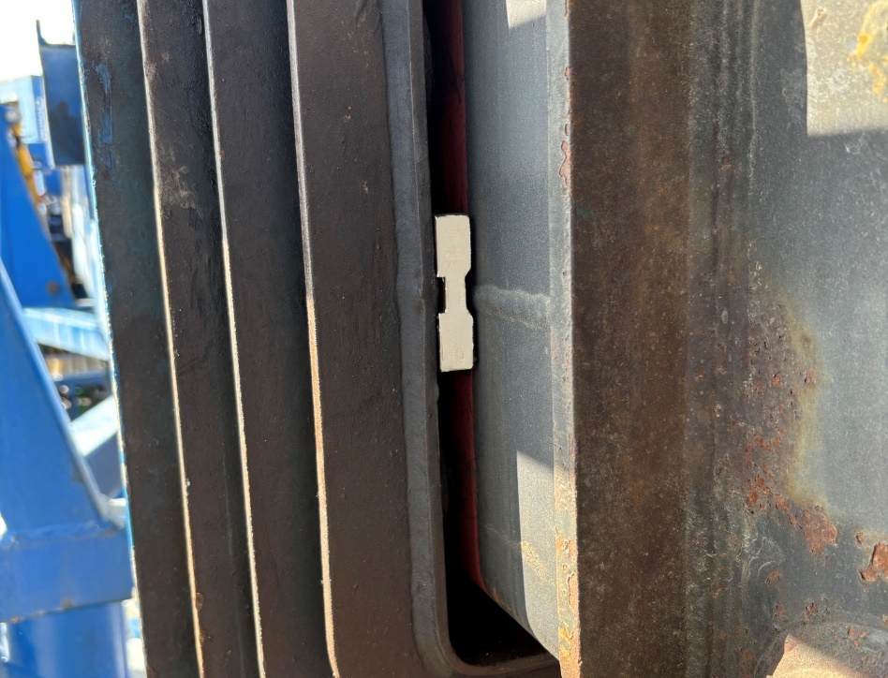
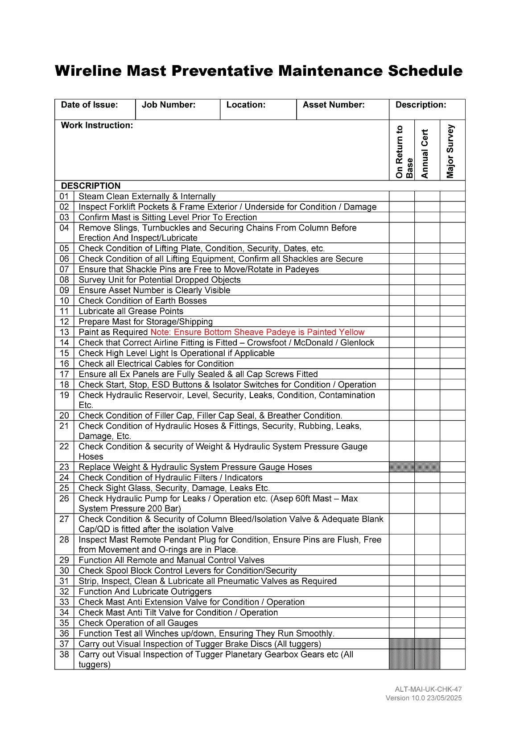
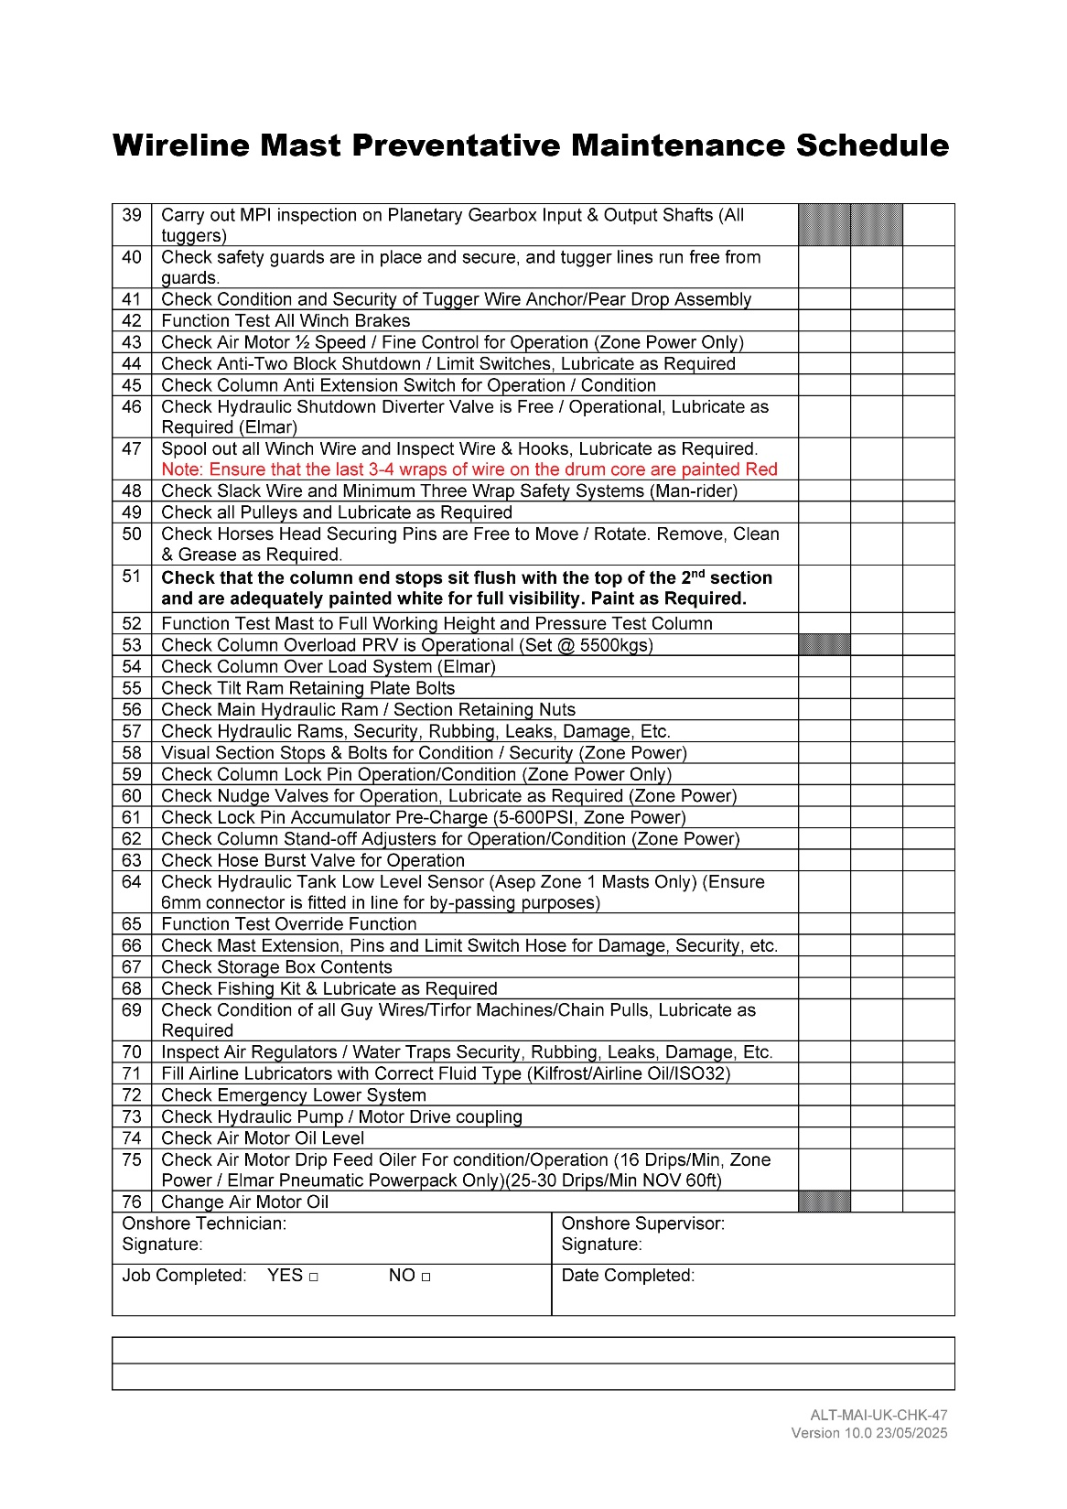
Corrective Actions and Improvements
The following actions and improvements have been taken:
Refit mast column stop plates with replacement bolts, verify alignment and apply paint to the upper (visible) section of plate to visually confirm correct orientation.
Update maintenance checklist to ensure that the stop plate orientation is checked during every maintenance activity.
Produce new maintenance procedure for stripping and rebuilding the mast column to include highlighting the safety-critical nature of the plate orientation.
Publish technical bulletin for maintenance personnel and made available for reference during any additional inspection.
Share learnings through industry initiatives such as DROPS and Step Change for Safety.
LEARNING FROM INCIDENTS

Slide 12
Thank You
For more information please contact admin@dropsonline.org
Published by DROPS (Dropped Object Prevention Scheme) JULY 2025

